Slide 1
Cloudera Data Platform - CDP
Presales Deep Dive
The session will begin shortly

Slide 2





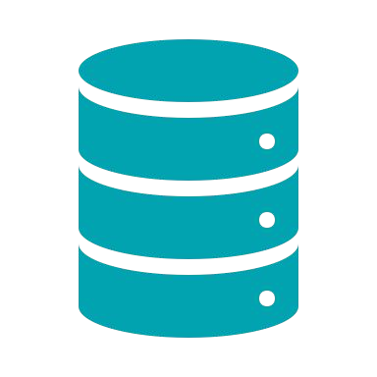









AGENDA
- Cloudera at a glance
Enterprise Data Cloud
Cloudera Data Platform
CDP Demo
More on CDP Technicals
Packaging, Pricing & Value Proposition
Q&A
© 2020 Cloudera, Inc. All rights reserved.
2

Slide 3

CLOUDERA AT A GLANCE

Slide 4
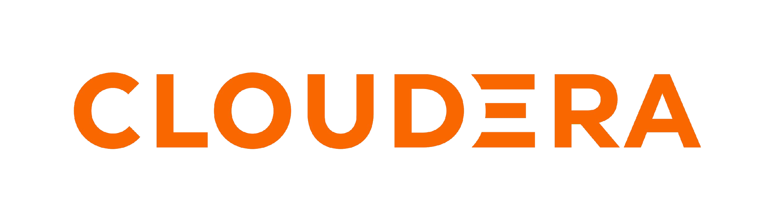

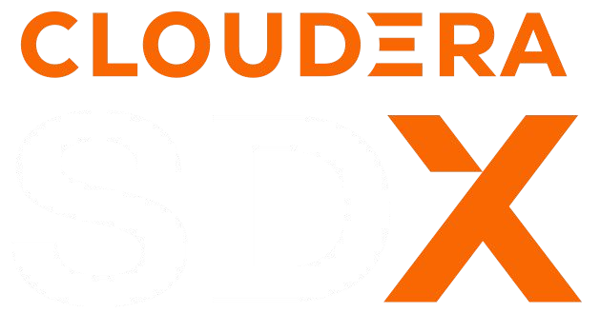

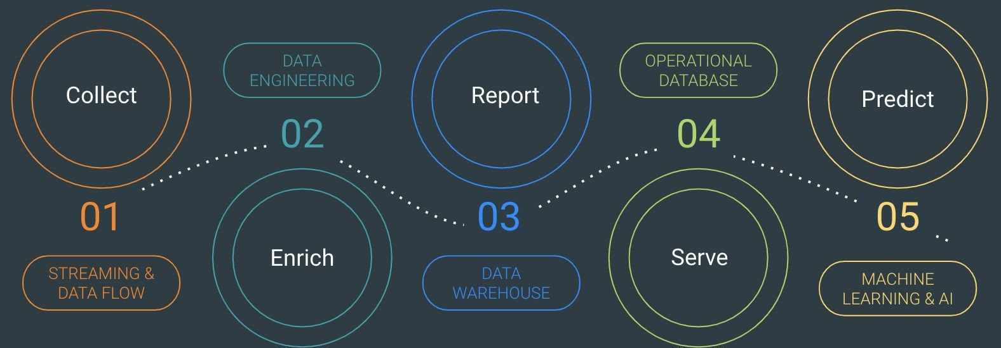
THE ENTERPRISE DATA CLOUD COMPANY
Any Cloud
Data Lifecycle
Secure & Governed
Open
4

Slide 5
HOW DO CUSTOMERS USE CLOUDERA?
Every business use case is a data lifecycle use case
BANKING
TECHNOLOGY
TELCO
LIFE SCIENCES
MANUFACTURING
Fraud detection
Anti-money
laundering
Spend analytics
Customer analytics
Threat detection
Predictive
support
Churn analysis
Customer care
Network
optimization
Patient care (IoT)
Genomics research
Predictive
maintenance (IoT)
Supply chain
optimization
USE CASES
Regulatory
compliance
Remote monitoring
KEY CUSTOMERS
Barclays
Citi
Santander UK
Cisco
Globe Telecom
GlaxoSmithKline
Clearsense
Cerner
Navistar
Intel
Deutsche Telecom
Micron
Reef Technology
Robi Axiata
Sikorsky
4

Slide 6

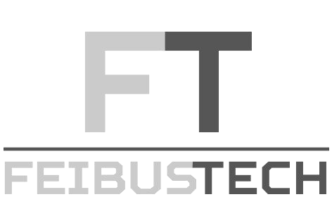

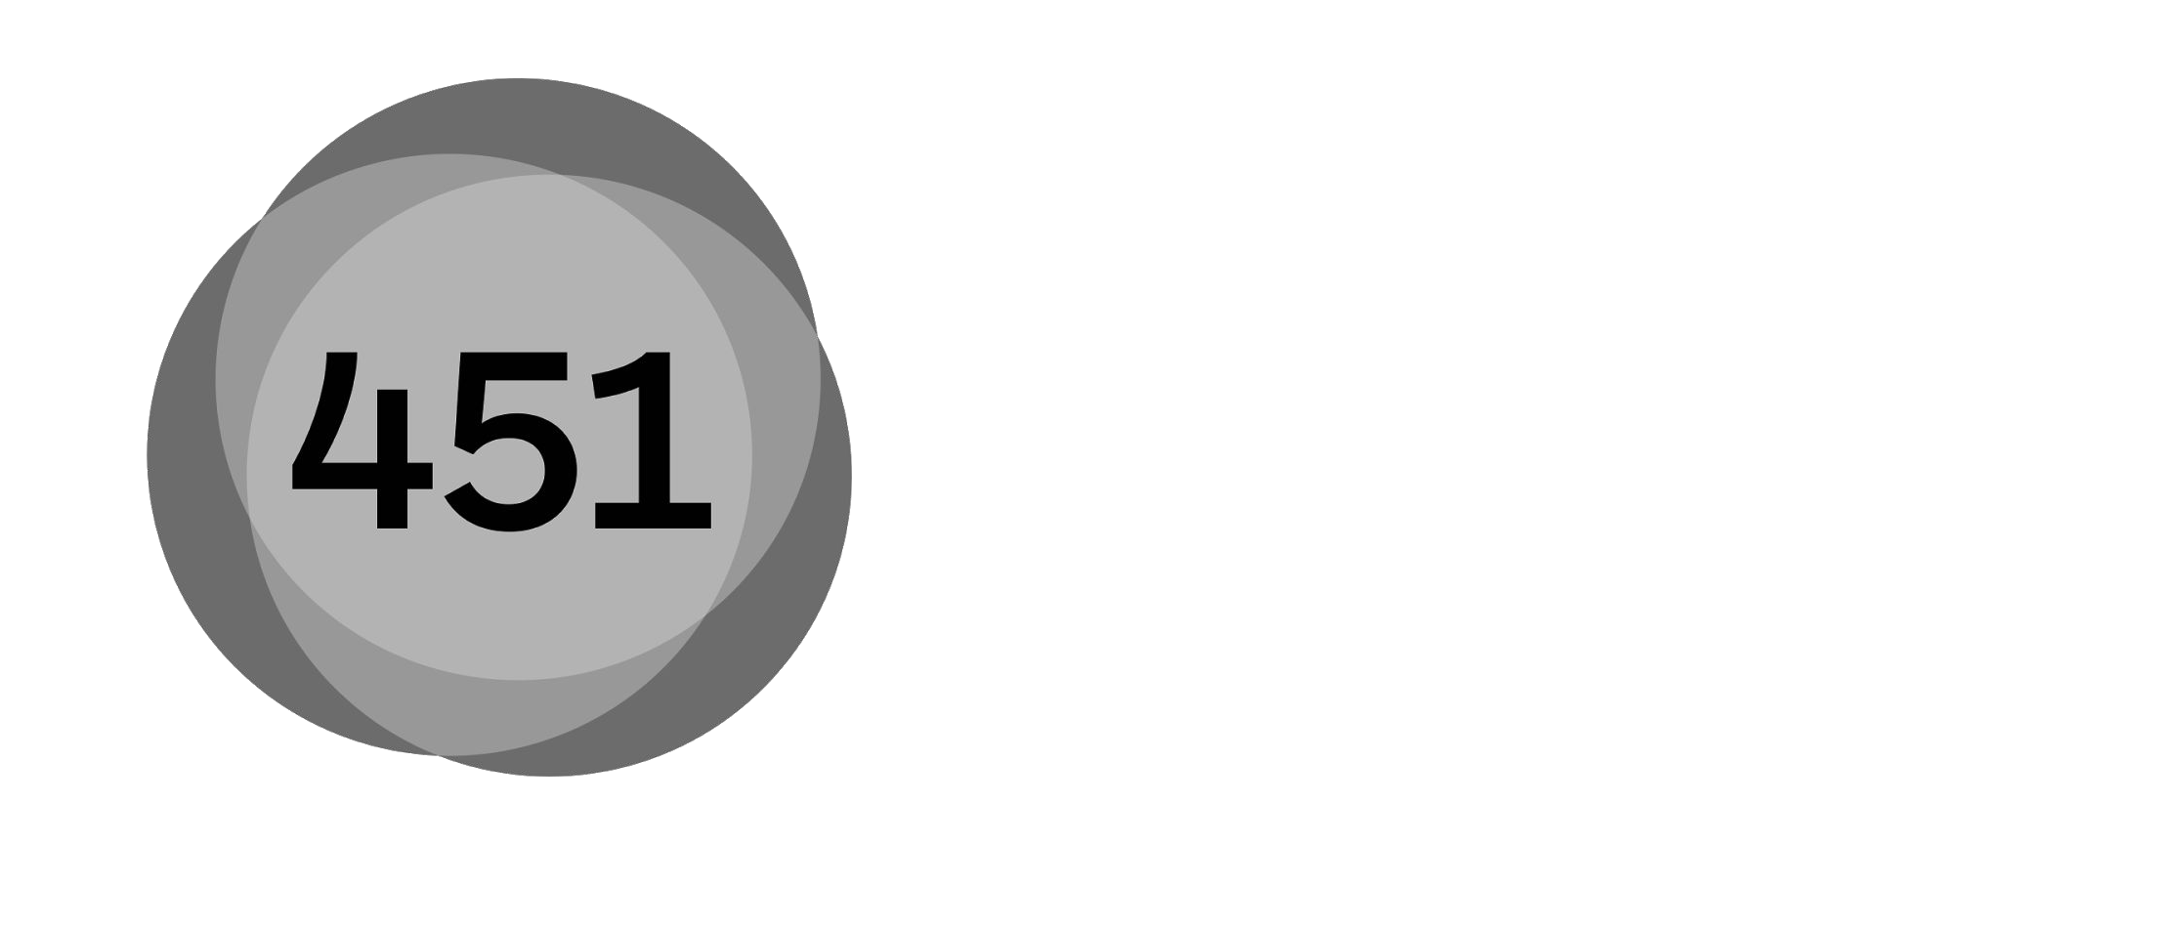
INDUSTRY ANALYST RECOGNITION
Enterprise Data Cloud Cloudera Data Platform (CDP)
Enterprise Data Platform
“...To realize the full potency of hybrid cloud, organizations really need a holistic approach to the entire data lifecycle. Before CDP, they had to assemble the pieces themselves
— a costly, time-consuming undertaking with potential gotchas lurking at every turn…”
January 2021
Cloud Data Ecosystems
January 18, 2021
January 2020
“...CDP is an enterprise data platform built on open-source software...that offers key data analytics and artiﬁcial intelligence functionality. CDP can leverage all data types, including structured and unstructured data, relational data and streaming data from any point in the data lifecycle.…”
Enterprise Intelligence Platforms
December 2019
January 22, 2021
4

Slide 7
ENTERPRISE DATA CLOUD

Slide 8


ENTERPRISES ARE EMBRACING PRIVATE CLOUD
IDC Research - Cloud Growth, Migration, and Repatriation Continue to Gain Momentum
Of enterprise workloads run on public and private cloud implementations
Of enterprises report repatriating some workloads from public cloud
Of repatriated workloads move to private clouds
“As enterprise customers gain cloud expertise they’re placing investments in private cloud solutions for increased security, compliance, performance, control and cost savings.
Private clouds often act as a stepping-stone in the hybrid cloud journey.”
IDC, Cloud Growth, Migration, and Repatriation Continue to Gain Momentum, Michelle Bailey, Chris Kanthan, March 2020 IDC, Cloud Pulse 1Q20: Survey Findings, Doc # US46396720, May 2020

Slide 9
DATA AND INSIGHT SILOS
APPLICATION
IOT, INGEST, STREAMING
ETL & DATA ENGINEERING
DATA WARE- HOUSE/MART
NOSQL & RT DATABASE
DATA SCIENCE
CONTEXT
CATALOG SCHEMA SECURITY GOVERNANCE
CATALOG SCHEMA SECURITY GOVERNANCE
CATALOG SCHEMA SECURITY GOVERNANCE
CATALOG SCHEMA SECURITY GOVERNANCE
CATALOG SCHEMA SECURITY GOVERNANCE
STORAGE
FS
RDBMS
Public Cloud
RDBMS
Public Cloud

Slide 10
SEPARATE STORAGE AND COMPUTE AND STATE
Basic on prem architecture
Cloud optimised data architecture
Basic cloud-native architecture
Virtual Machines
COMPUTE
Virtual Machines
COMPUTE
COMPUTE
Always-On Service
STATE
STATE
Object Storage
STORAGE
STORAGE
Object Storage
STORAGE
Physical Servers

Slide 11
ENTERPRISE DATA CLOUD DESIGN PRINCIPLES
PUBLIC CLOUDS
compute & storage
DATACENTER
compute & storage
SECURITY & GOVERNANCE
Hybrid and multi-cloud
Secure and governed
Multi-function analytics
Open platform
IOT, INGEST & STREAMING
DATA WAREHOUSING
ML / AI DATA SCIENCE

Slide 12
CLOUDERA DATA PLATFORM

Slide 13
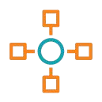
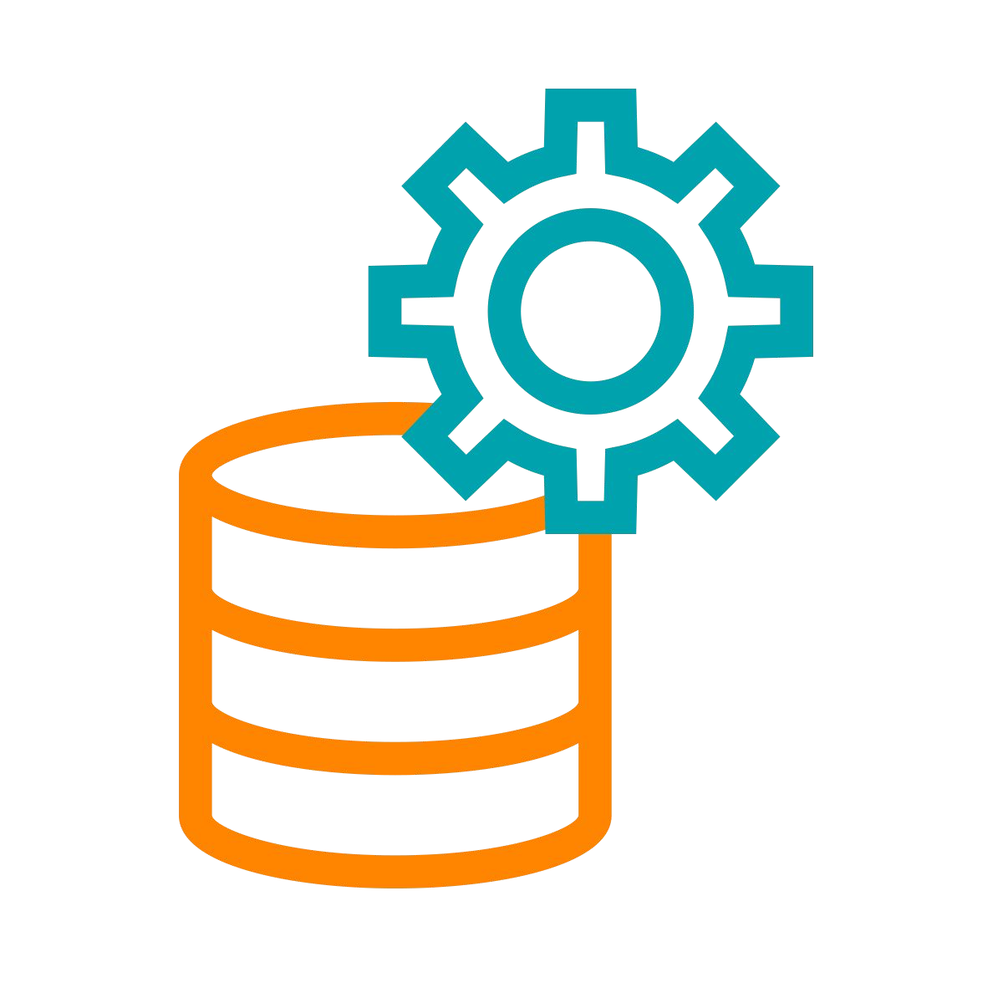
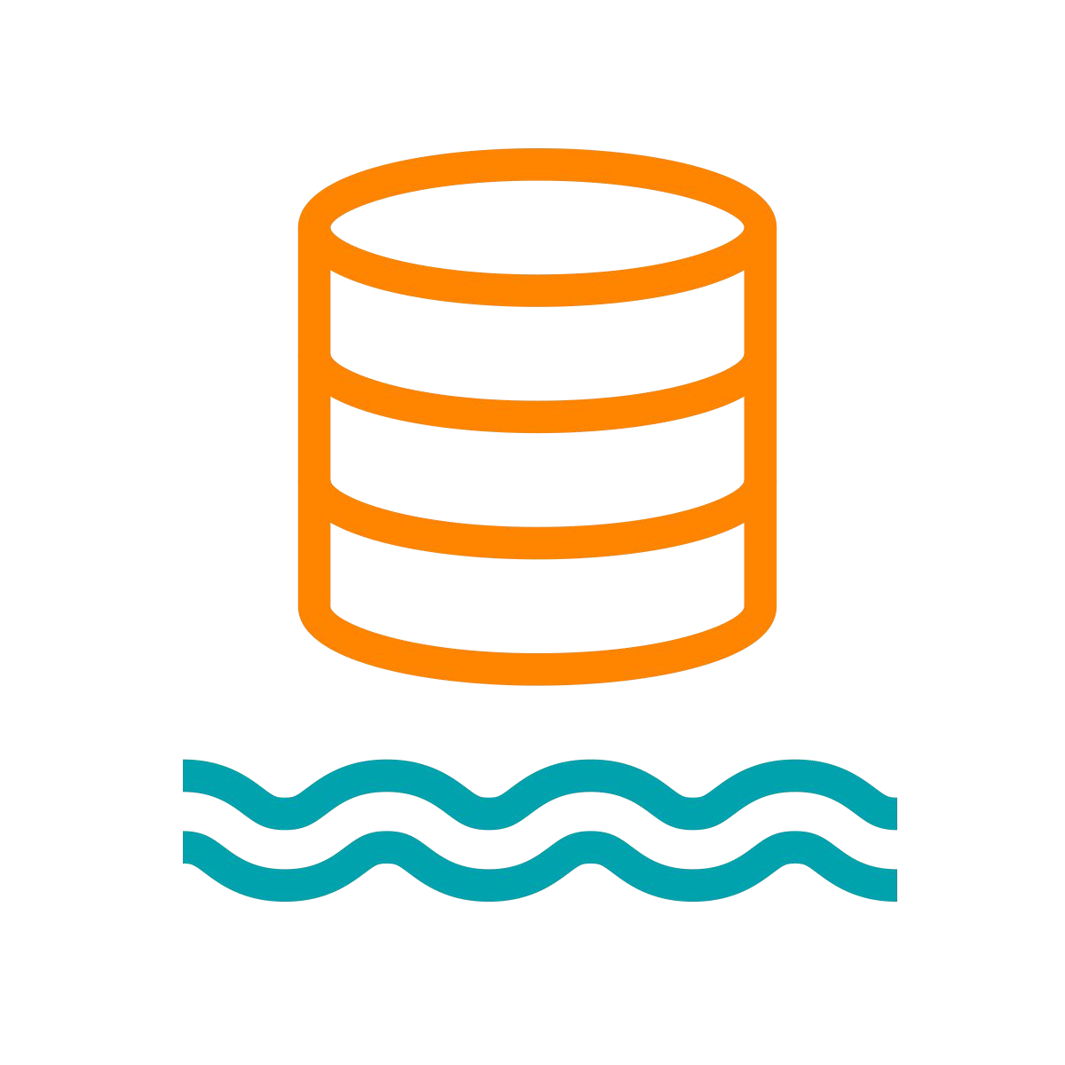
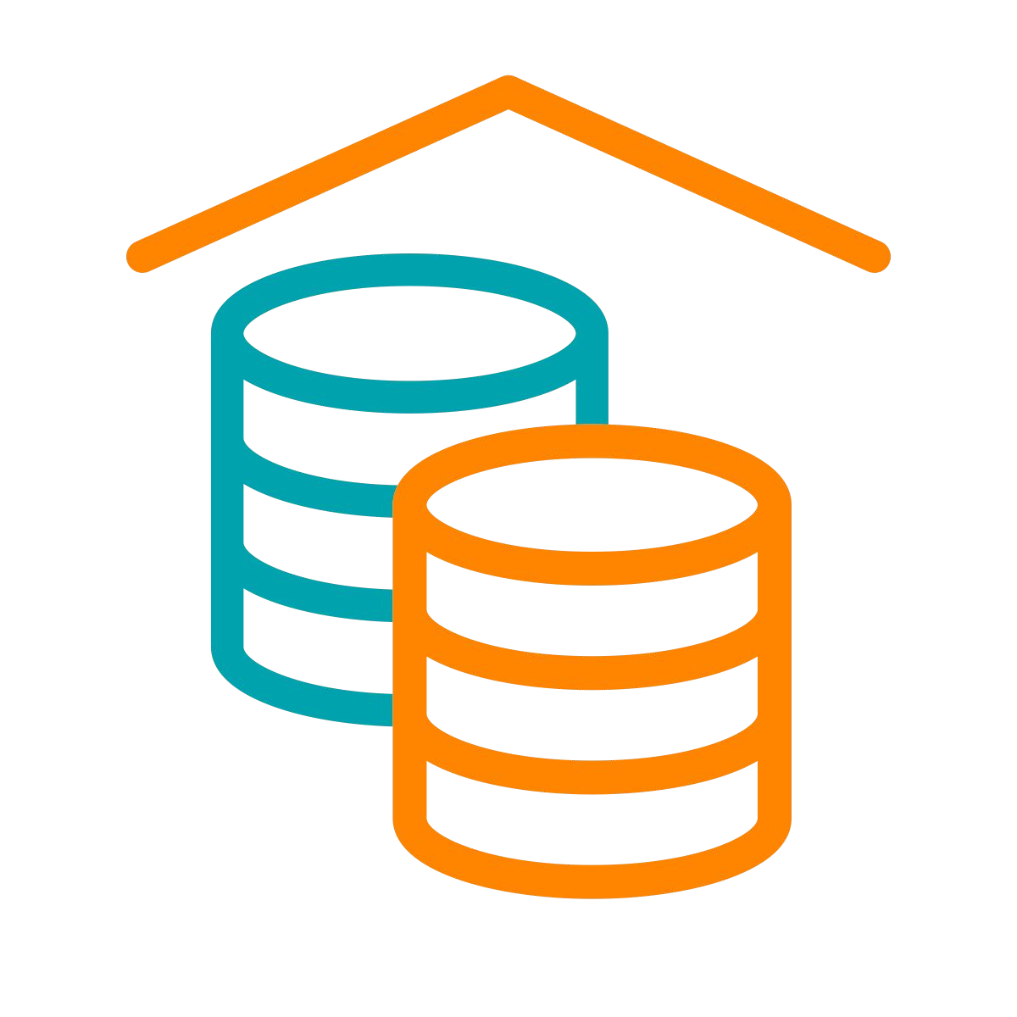
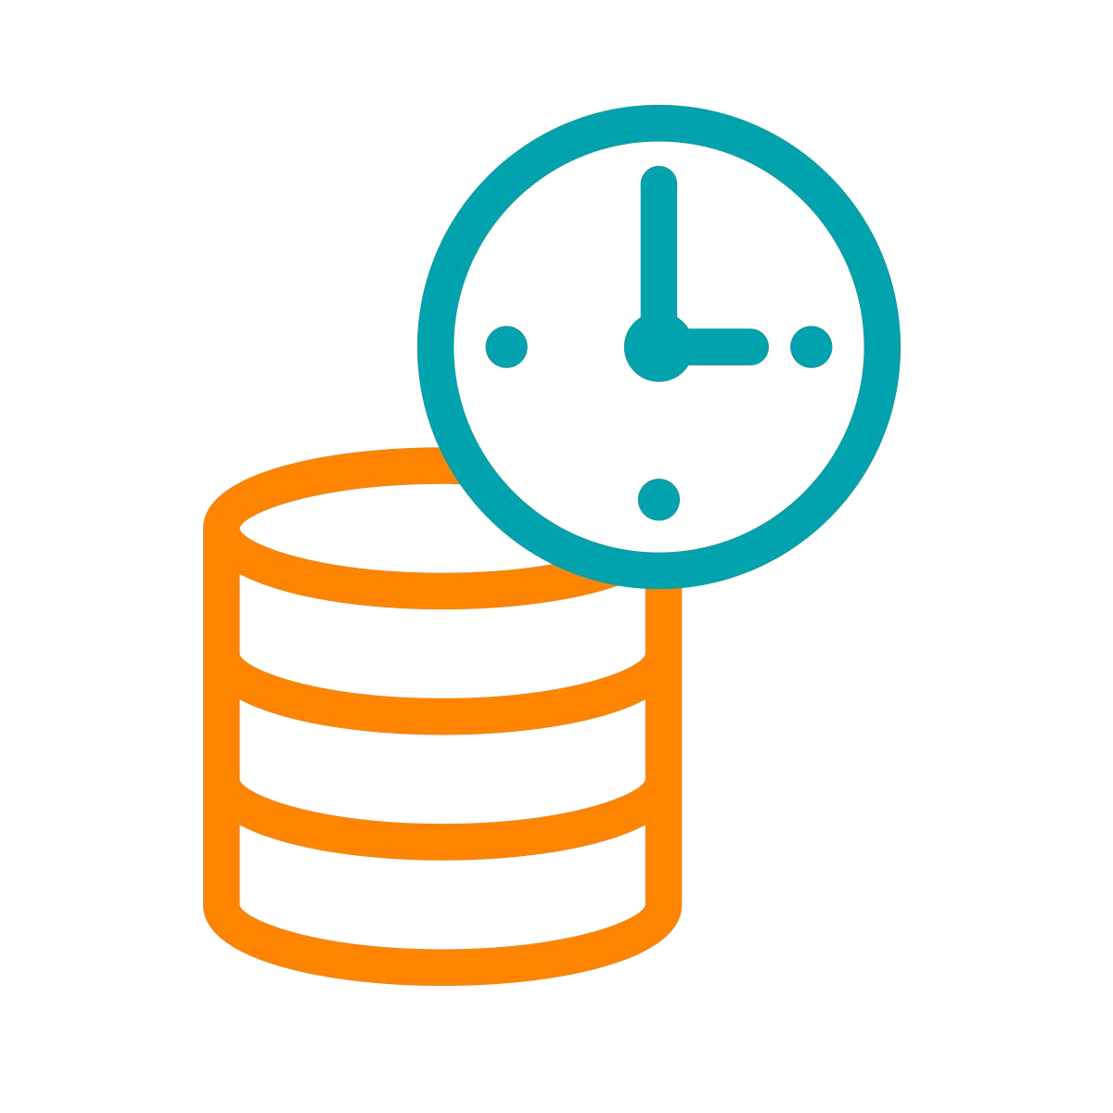

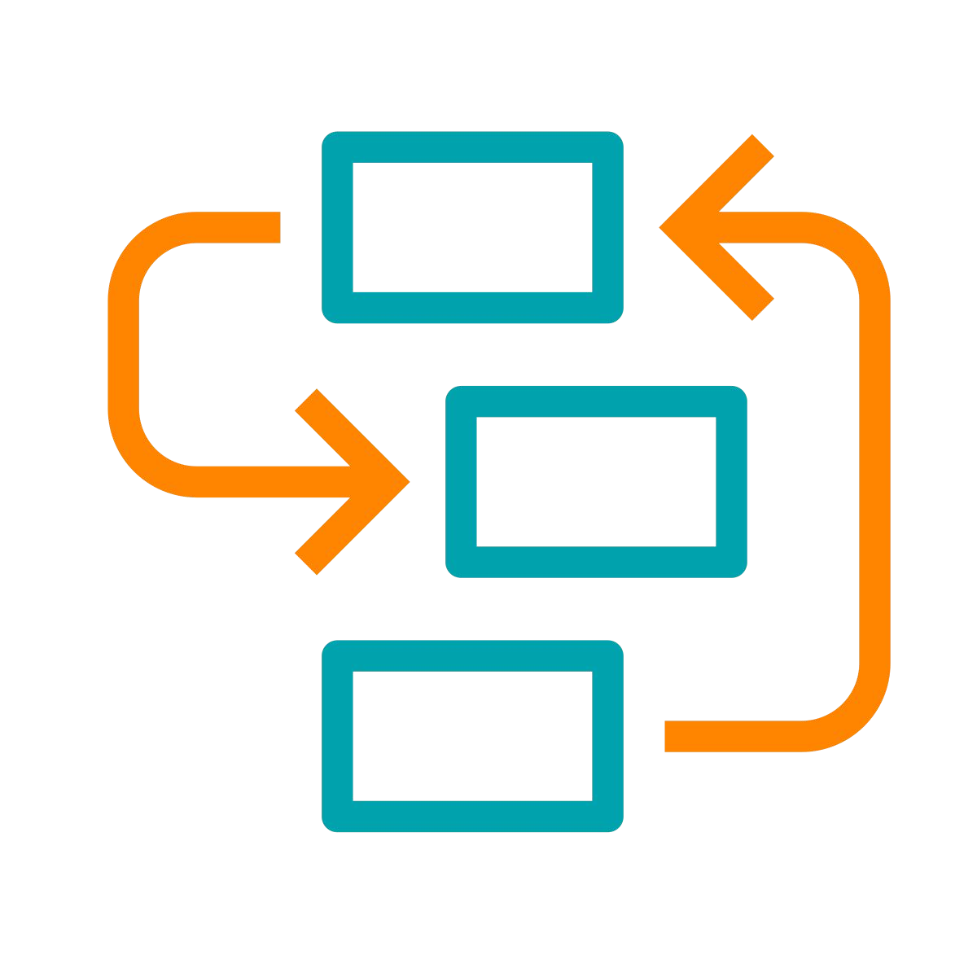
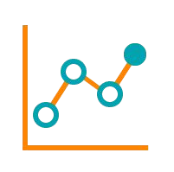







A HYBRID / MULTI-CLOUD DATA PLATFORM AND
AN INTEGRATED SUITE OF SECURE ANALYTIC APPS
Real-time Batch Structured Unstructured
Analysts Engineers Scientists Developers
Data Collection
Data Engineering
Virtual Data Lake
Data Warehouse
Operational Database
Streaming Analytics
Machine Learning
Data Visualization
Data Sources
Data Users
Cloudera Data Platform
Data Lifecycle integration for better user productivity and faster time to value
Hybrid & Multi-Cloud to leverage existing investments and reduce risk
Secure & Governed to simplify data protection, sharing and compliance
Open & Extensible to support more use cases faster and at lower cost

Slide 14
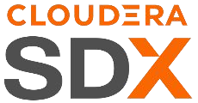
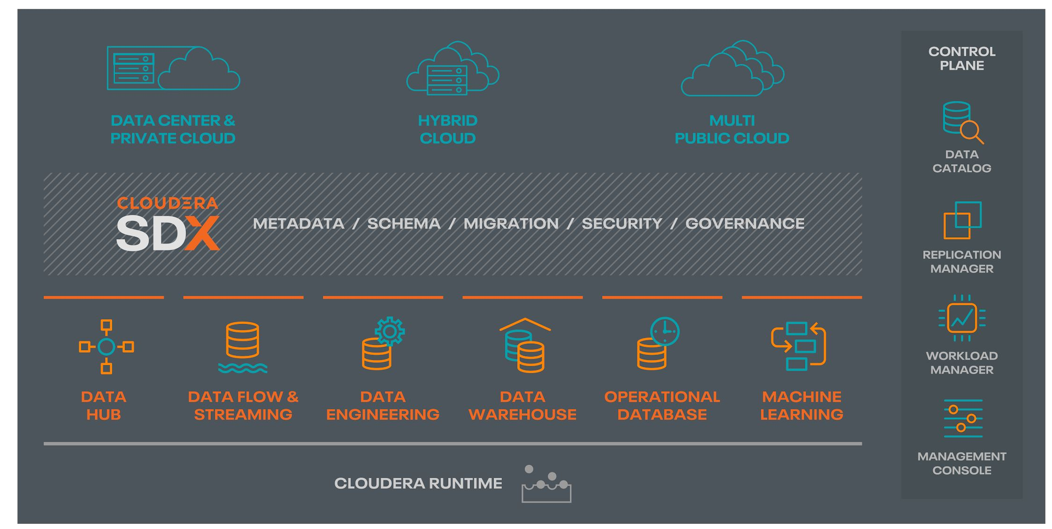
CONSISTENT SECURITY AND GOVERNANCE
Built for multi-functional analytics anywhere
Data Catalog: a comprehensive catalog of all data sets, spanning on-premises, cloud object stores, structured, unstructured, and semi-structured
Schema: automatic capture and storage of any and all schema and metadata definitions as they are used and created by platform workloads
Security: role-based access control applied consistently across the platform. Includes full stack encryption and key management
Governance: enterprise-grade auditing, lineage, and governance capabilities applied across the platform with rich extensibility for partner integrations
Replication: deliver data as well as data policies there where the enterprise needs to work, with complete consistency and security

Slide 15
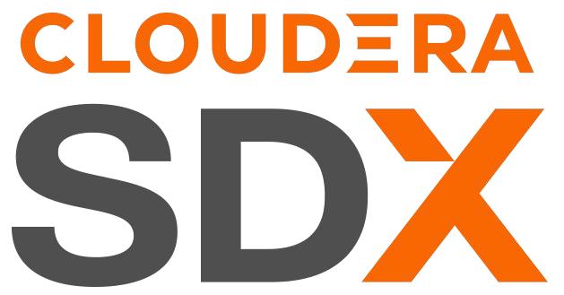
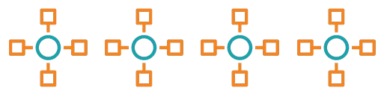
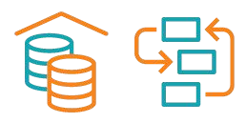
CDP - ONE PLATFORM, THREE FORM FACTORS
CDP PVC Base
(installable software)
CDP Private Cloud
(installable software)
CDP Public Cloud
(platform-as-a-service)
Cloudera Manager
CDP Control Plane
CDP Control Plane
Bare Metal
OEM
OpenShift
OpenShift
...
AWS
Azure
GCP
Bare Metal Workloads
HDFS
Self-Serve xperiences
Vi
rtual Private Clusters
Self-Serve xperiences
E
E
DW, ML, DE, …
Data Hub
DW, ML, DE, …
HDFS + Ozone
Cloud Storage
Cloudera Runtime
Cloudera Runtime
Cloudera Runtime

Slide 16

CDP HYBRID CLOUD
Consistent operations and analytics experiences across private and public clouds
Analytic Experiences
Analytic Experiences
MANAGEMENT CONSOLE
DATA CATALOG | REPLICATION MANAGER | WORKLOAD MANAGER
CDP
Private Cloud
CDP
Public Cloud
DF DE DW OD
K8S Containers - OCP, OKE, etc.
ML
DF DE DW OD
K8S Containers - EKS, AKS, etc.
ML
Base
Base
FILE & OBJECT STORE HDFS | OZONE
BASE CLUSTER
OBJECT STORE
S3 | ADLS
DATA HUB
Bare Metal Servers
Virtual Servers

Slide 17
CLOUDERA DATA PLATFORM – PUBLIC CLOUD
Available on AWS, Azure & GCP
VM-based Data Lake and Data Hub clusters
Containerized workloads:
CDP Public Cloud
(platform-as-a-service)
CDP Control Plane
Cloudera Data Warehouse (CDW)
Cloudera Machine Learning (CML)
Cloudera Data Engineering (CDE)
Cloudera Operational DB (COD)
Cloudera Data Flow
AWS
Azure
GCP
Vi
rtual Private Clusters
Self-Serve xperiences
E
Unlike other public cloud services, your data will always remain under your control in your VPC
Control cloud costs by automatically spinning up workloads when needed and suspending their operation when complete
Data Hub
DW, ML, DE, …
Cloud Storage
Cloudera Runtime

Slide 18

CDP PUBLIC CLOUD | UNIQUE CAPABILITIES
Self-Service Analytics
Data warehouse
Machine learning
Data hub
Flow management
Shared data experience
Intelligent Migration
Improve cluster utilization with highly variable jobs
Deliver optimal capacity to meet workload SLAs
Improve cost eﬃciency by freeing on-prem resources for more predictable workloads
Adaptive scaling
Adjust capacity up or down to optimize workload performance automatically
Eliminate the need to size workload requirements that can't be reliably predicted
Speed up deployment while effectively managing costs
Burst to Cloud
Easily and quickly move workloads, data, metadata, policies, etc.
Provide the “right” amount of cloud capacity to meet SLAs
Isolate “noisy neighbors”

Slide 19
CLOUDERA DATA PLATFORM - PRIVATE CLOUD
A new product offering, CDP Private Cloud provides the ability to:
Extend compute capacity from today’s VM/Bare-metal based CM/CDH deployments onto Kubernetes infrastructure
Leverage Cloudera workloads (ML, Spark, Impala, Hive etc.) that they already leverage in CDP Public Cloud (AWS and Azure) on-premises.
Management Console
Data Catalog
Experiences
Workload Manager
Replication Manager
Machine Learning
Data Warehouse
Data Engineering
DataFlow
Container Platform
Bare Metal Workloads
SDX
Security
Metadata Governance
HDFS / OZONE
BareMetal

Slide 20
WHY CDP PRIVATE CLOUD?
1. Workload Isolation
2. Simpliﬁed Onboarding
3. Better Infrastructure Utilisation
No Noisy Neighbours
Dedicated compute per tenant
Push-button Provisioning
Up and running in seconds
Auto-scale, Auto-suspend
Use what you need, when you need it
Independent Upgrades
Upgrade when needed
Redesigned User Interfaces
Use-case optimised workﬂows
Shared Kubernetes
All experiences on a single platform
Modern Standards
Container-based multi-tenancy
Quota Management
Set mins and max per tenants

Slide 21
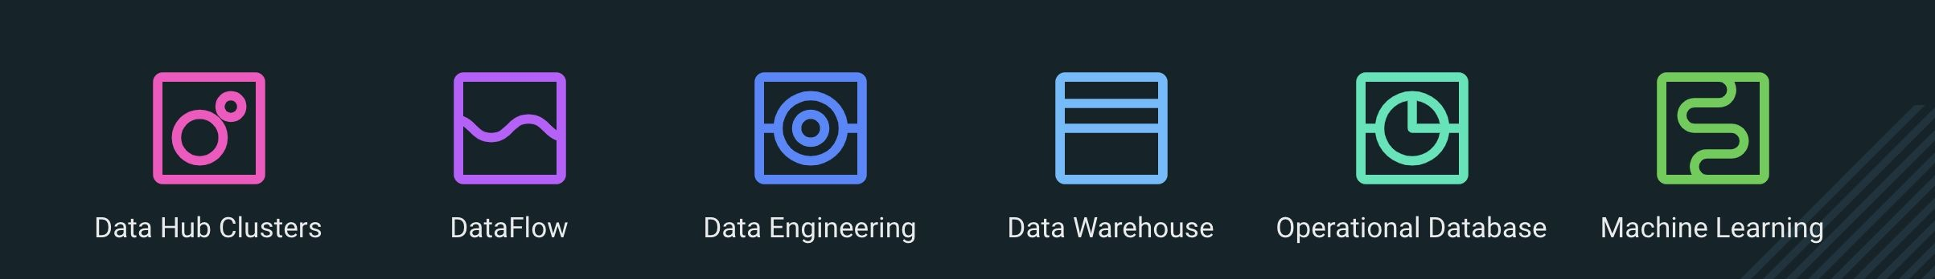
DATA HUB CLUSTERS AND DATA SERVICES
What are the consumption options?
A Data Hub Cluster is a customizable environment that runs like a traditional Hadoop cluster, but is designed to leverage Cloud Storage.
An Experience is a container-based compute environment for speciﬁc purposes: ML, DW, DE, OD, DF

Slide 22
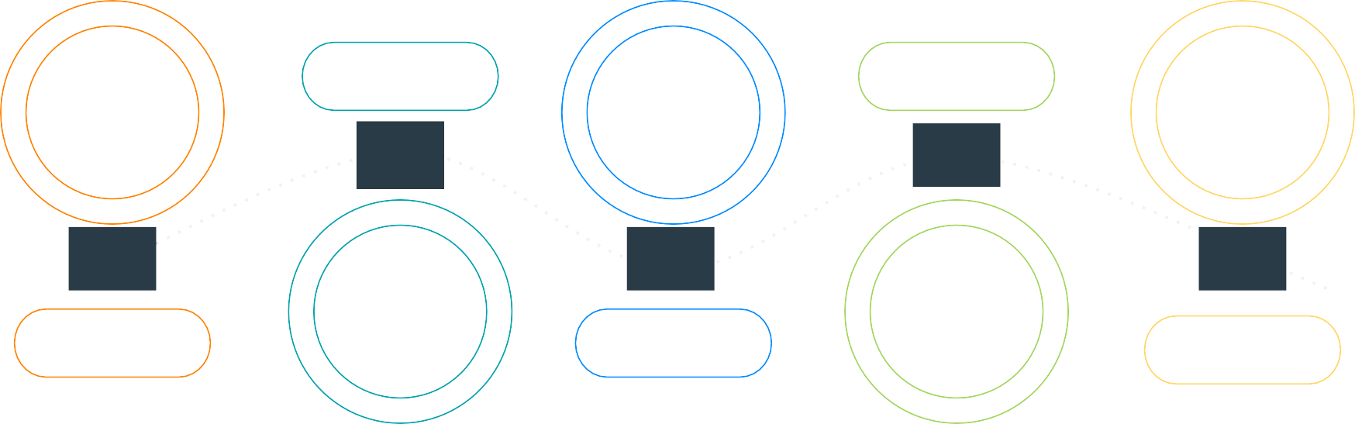
CLOUDERA - THE ENTERPRISE DATA CLOUD COMPANY
Manage and secure the data lifecycle in any cloud or datacenter
DATA ENGINEERING
OPERATIONAL DATABASE
Collect
Report
Predict
02
04
01
STREAMING & DATA FLOW
03
DATA WAREHOUSE
05
MACHINE LEARNING & AI
Enrich
Serve
SECURITY | GOVERNANCE | LINEAGE | MANAGEMENT | AUTOMATION

Slide 23
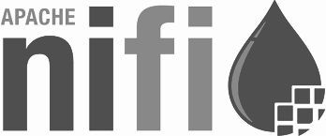


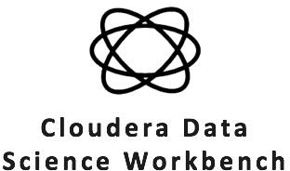
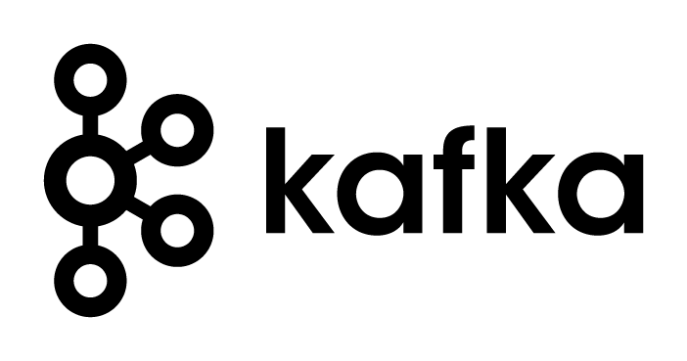

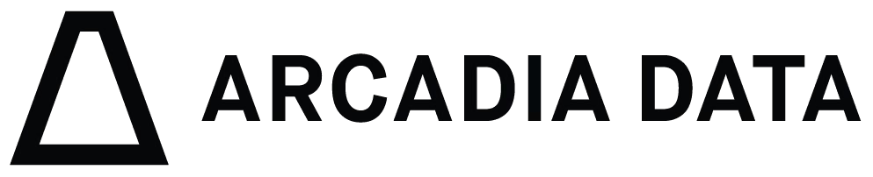
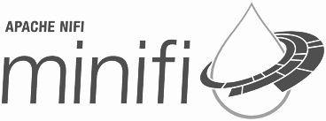
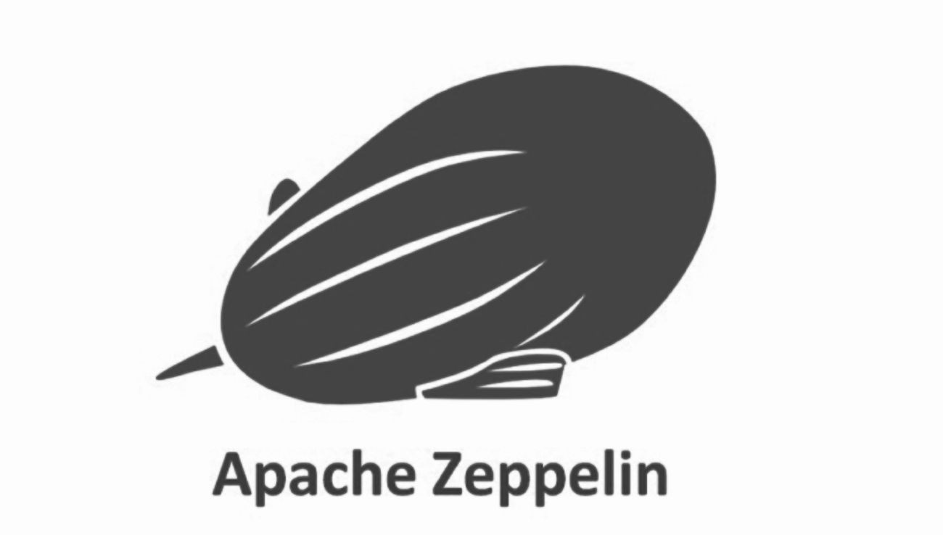


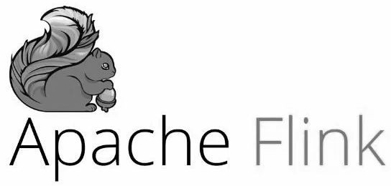




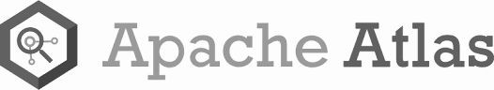
... A RUNTIME FOR THE ENTERPRISE DATA LIFECYCLE
What is the industry’s best enterprise-grade blend of data management framework?
Collect
Report
Predict
DATA ENGINEERING
OPERATIONAL DATABASE
02
04
01
Enrich
03
DATA WAREHOUSE
Serve
05
MACHINE LEARNING & AI
STREAMING & DATA FLOW
SECURITY | GOVERNANCE | LINEAGE | MANAGEMENT | AUTOMATION

Slide 24
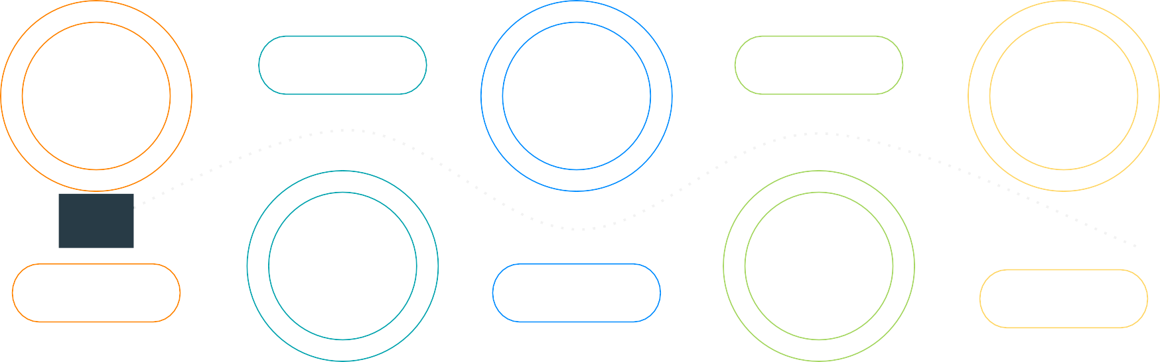
CONNECTING THE DATA LIFECYCLE
Starting the data lifecycle journey - solving the “ﬁrst mile” problem
DATA OPERATIONAL
ENGINEERING DATABASE
Report Predict
02 04
03 05
Enrich Serve
^{DATA} MACHINE
^{WAREHOUSE} LEARNING & AI
CDF
01
STREAMING & DATA FLOW
SECURITY | GOVERNANCE | LINEAGE | MANAGEMENT | AUTOMATION

Slide 25
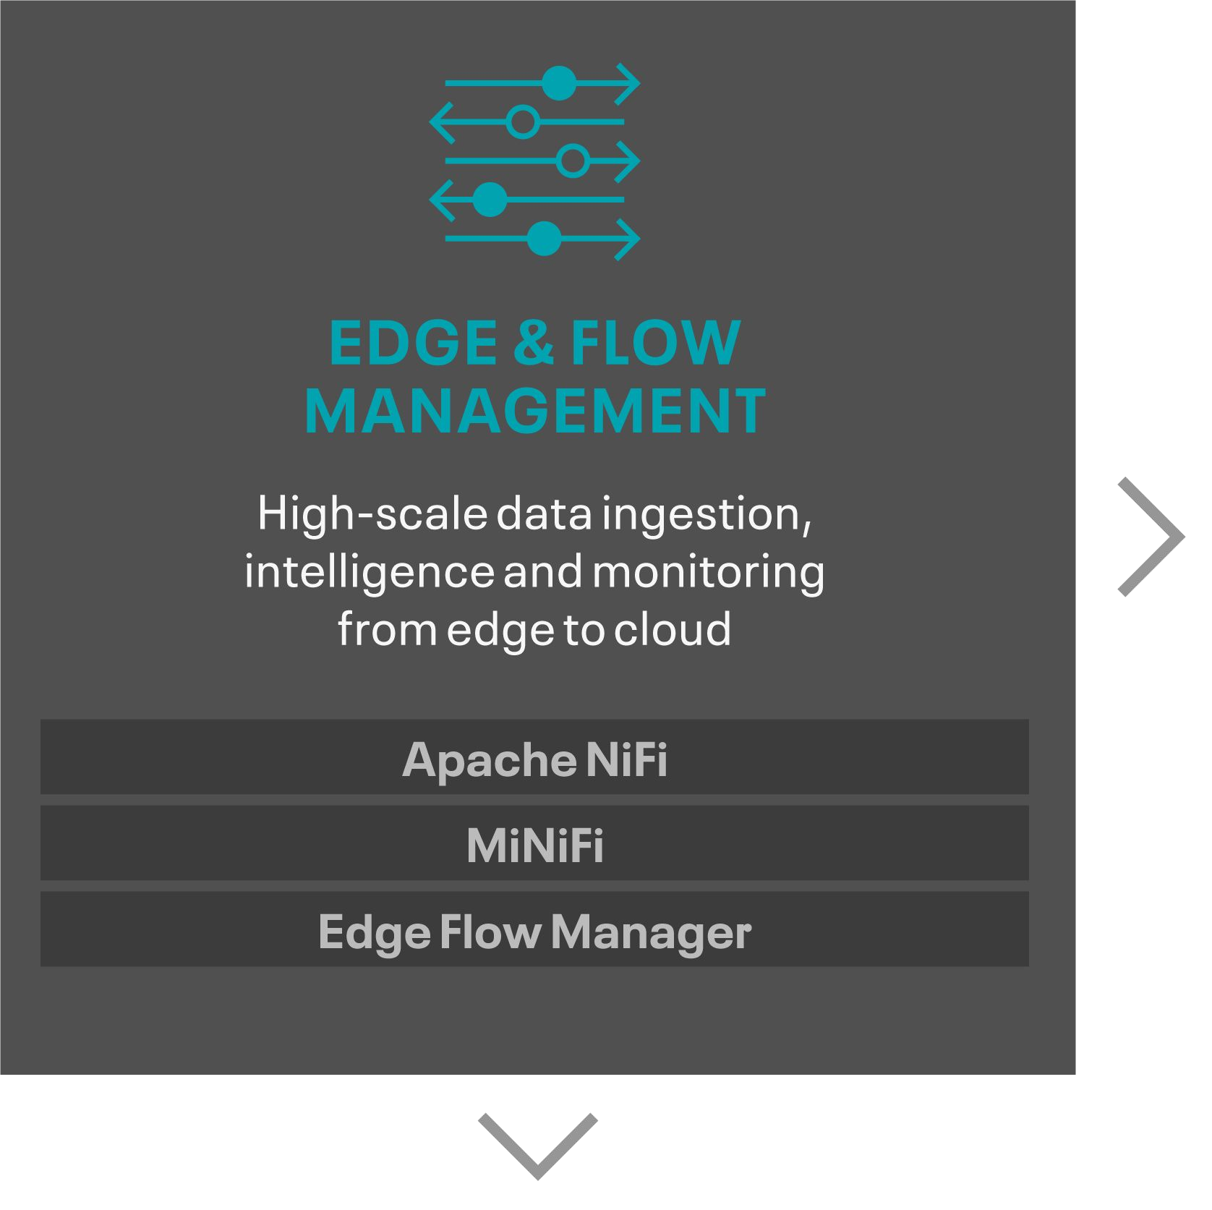
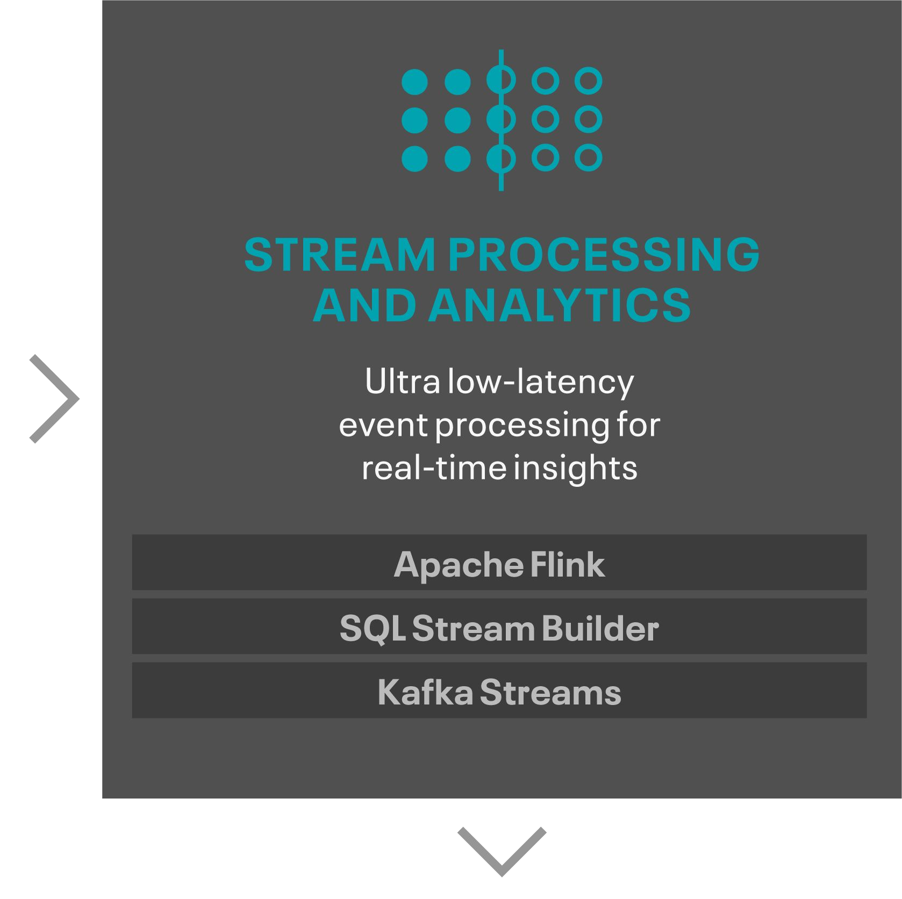
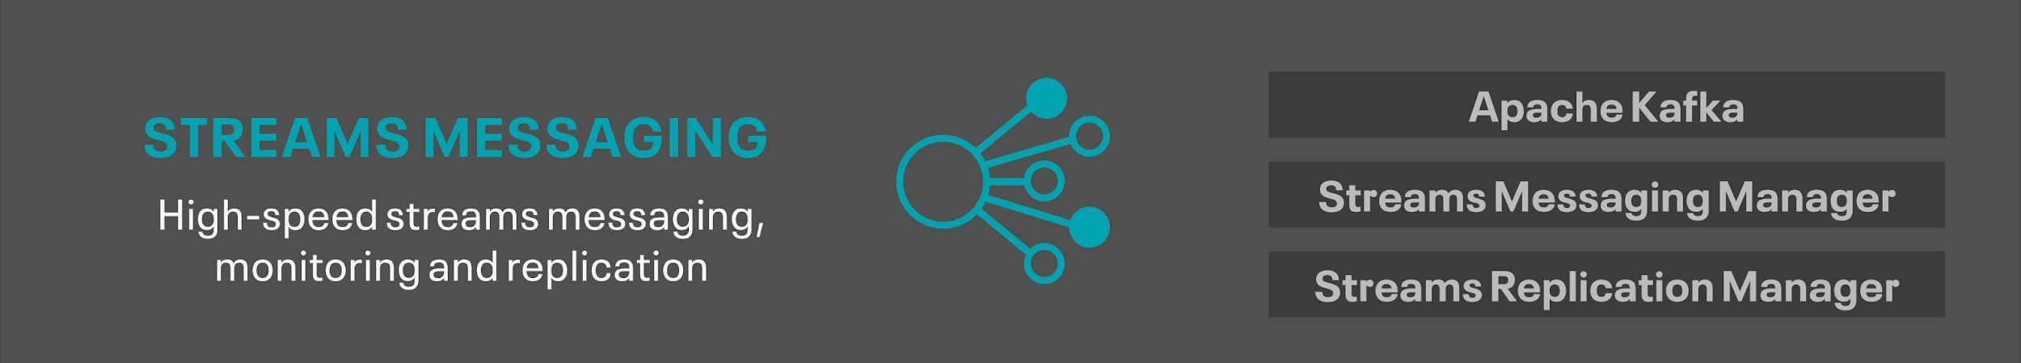
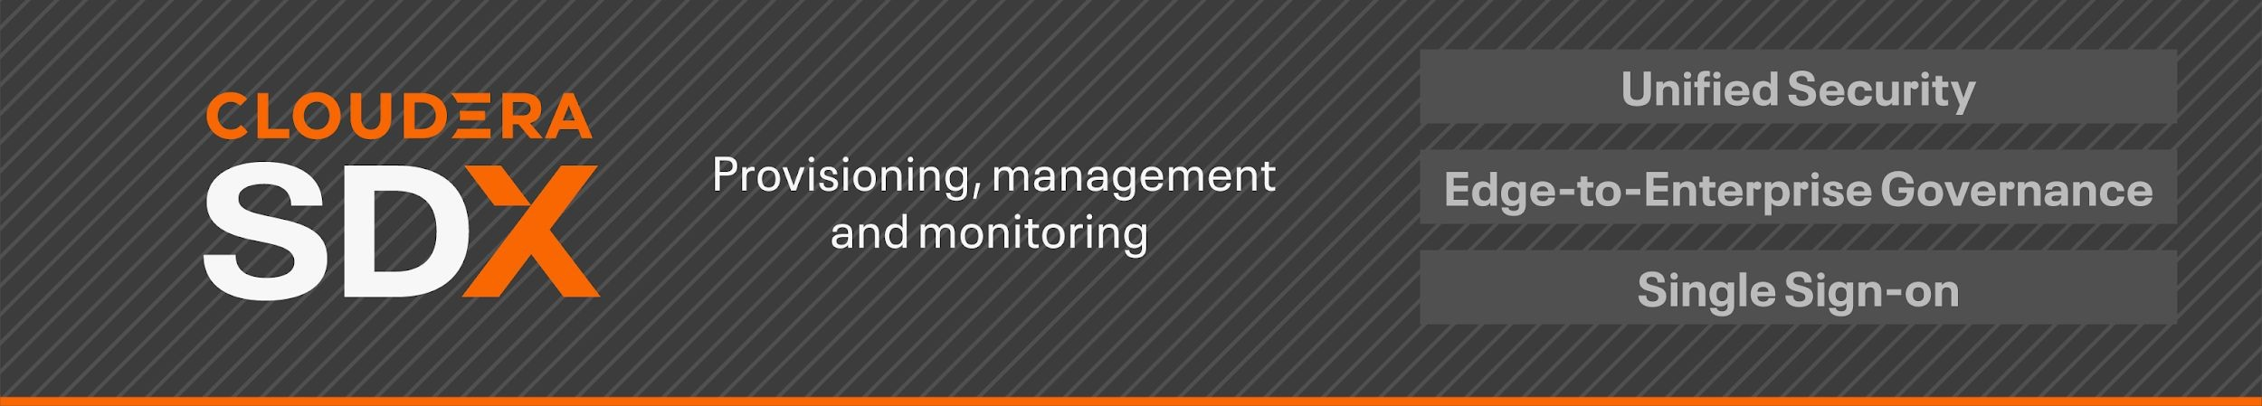
CLOUDERA DATAFLOW DATA-IN-MOTION PLATFORM

Slide 26
CLOUDERA DATAFLOW SERVICE “EXPERIENCE” (CDF)
A complete SDLC experience for data pipelines from dev through prod
Cloudera DataFlow
Servers/Clusters/Runtimes
(NiFi, Kafka, Flink)
Cloudera DataFlow Experience
Flows (H1)
Schema Aware
Topics (H2)
Schema Aware
Stream Apps (H2)
Schema Aware
Data Pipelines
Simpliﬁes app development by enabling developers to focus on business logic

Slide 27
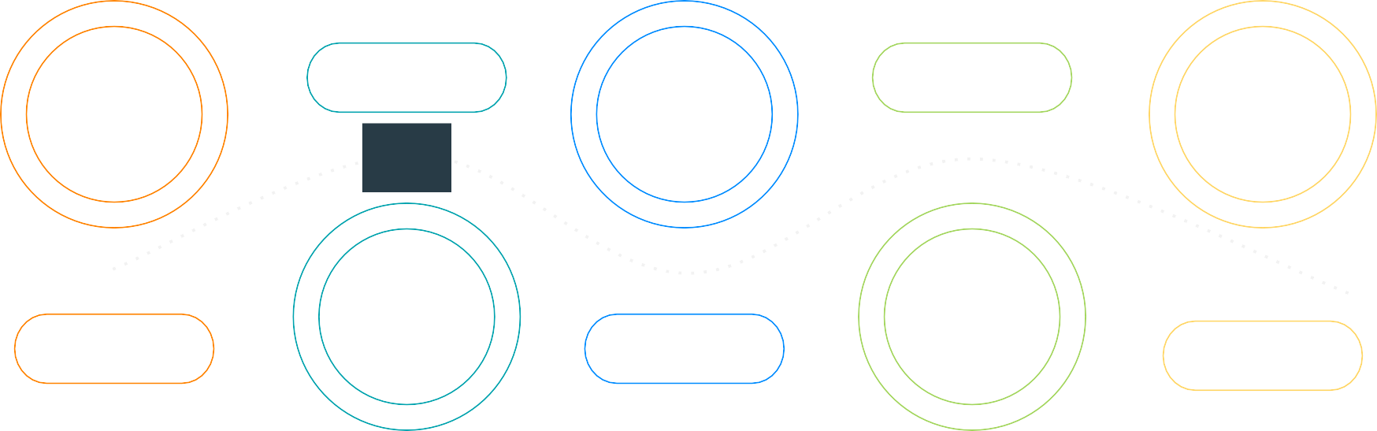
CONNECTING THE DATA LIFECYCLE
Enriching the data lifecycle journey
DATA ENGINEERING
OPERATIONAL DATABASE
Collect
01
STREAMING & DATA FLOW
Report
Predict
02
04
03
DATA WAREHOUSE
05
MACHINE LEARNING & AI
CDE
Serve
SECURITY | GOVERNANCE | LINEAGE | MANAGEMENT | AUTOMATION

Slide 28




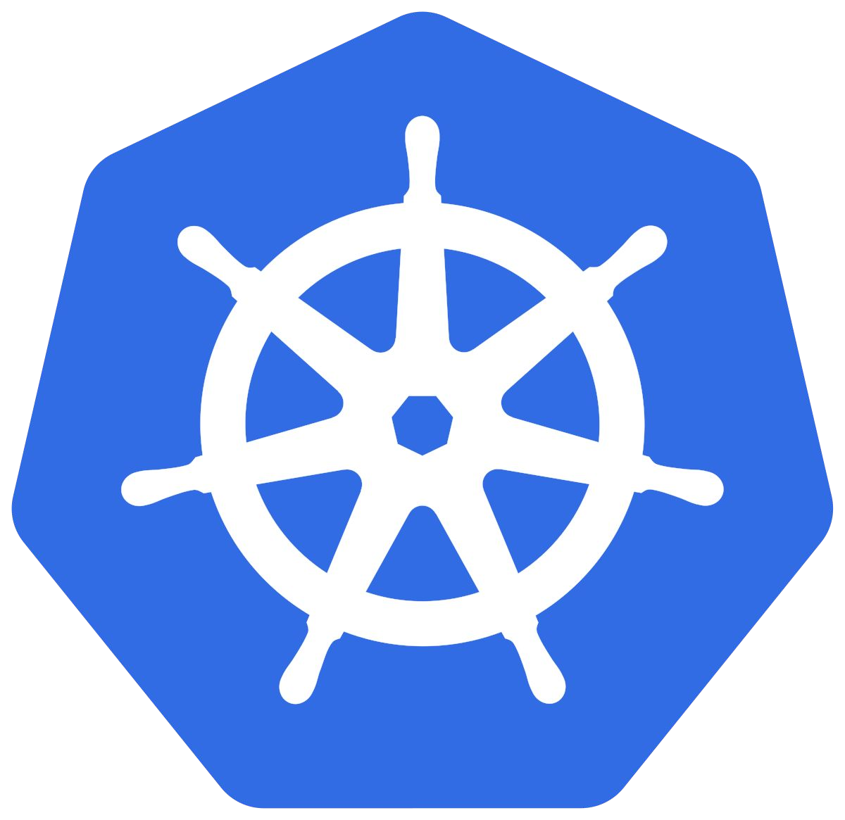

CLOUDERA DATA ENGINEERING
Seamless Integration
Management UI
CLI
API
Job management
Orchestration w/Airﬂow
Self-service visual troubleshooting
Dependency management
Artifact Versioning
Automatic lineage
Platform operations
Autoscaling (Yunikorn)
1-click provisioning
Containerized & Isolated
Monitoring (Prometheus
/Grafana)
Mix version
Spark run time
Data anywhere

Slide 29



TARGET PERSONAS
MANAGING RESOURCES & MANAGING JOBS
Management Console
Platform Admins
Data Engineer
AWS
Containerized
Quickly provision new workloads
Ensure isolation across LoB
Resource guardrails
Control costs through on-demand autoscaling
Show resource usage over time
Centralized Access controls & governance
Easy deployment & monitoring of jobs
Self-service troubleshooting with rich visual analysis
Powerful workﬂow scheduling
Automatic lineage capture
Multiple versions of Spark
Experience
Azure
DE Service
Private Cloud
SDX
KNOX
RANGER
HMS
ATLAS

Slide 30
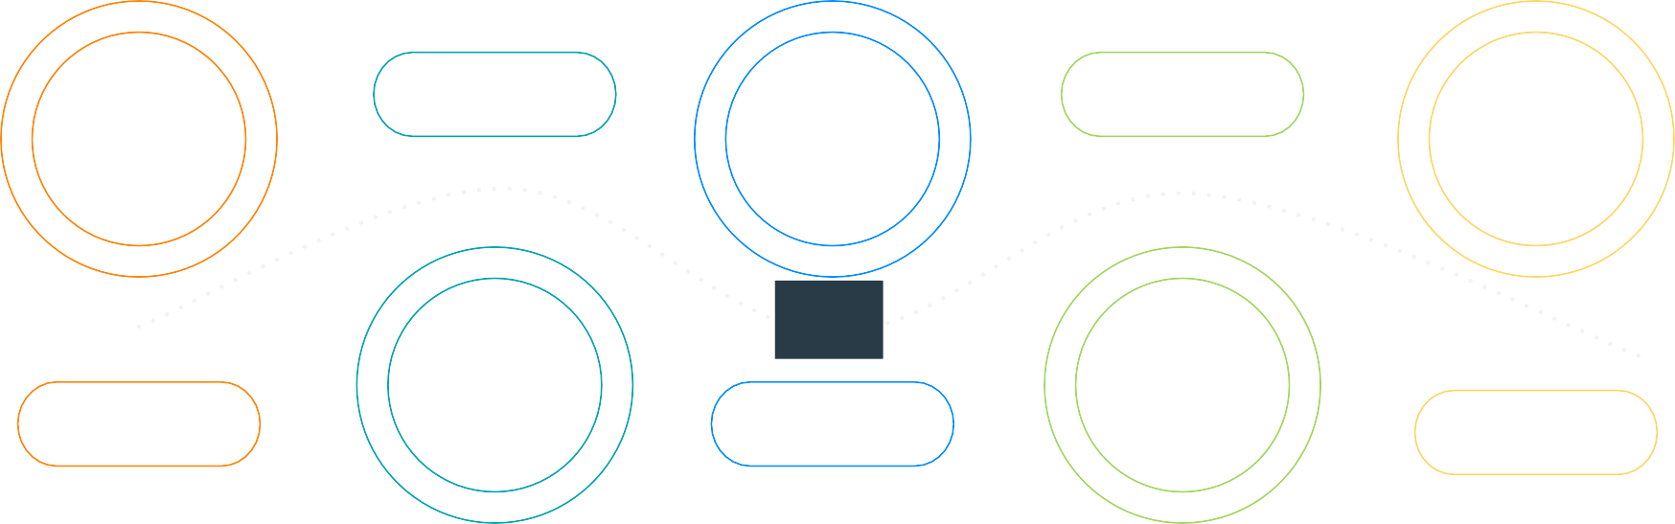
CONNECTING THE DATA LIFECYCLE
Enriching the data lifecycle journey
DATA
ENGINEERING
Collect
02
01
STREAMING & ^{CDE}
DATA FLOW
OPERATIONAL DATABASE
Report
Predict
04
03
DATA WAREHOUSE
05
MACHINE LEARNING & AI
Serve
SECURITY | GOVERNANCE | LINEAGE | MANAGEMENT | AUTOMATION

Slide 31

CDW is a managed data warehouse service that runs Cloudera’s powerful engines on a containerized architecture to let you meet SLAs, onboard new use cases with zero friction, and minimize cost

Slide 32
Two Cloud-Native Solutions for CDW
Management Console
DW Service
Kubernetes orchestration of container-based compute for agile clusters
Opinionated and packaged provisioning / scaling
Commonly administered by Line of Business
Simplicity and ease of use over customization and control
DW Template
Native VM clusters for complex long running workloads (BI, ETL)
Bespoke and ﬂexible provisioning / scaling
Typically administered by Central IT
Customization and control over simplicity and ease of use
Containerized
Virtual Machine Experience
Experience
DW
DW Service
Template
SDX
AWS
Azure
Private*
GCP*
* Future Release

Slide 33
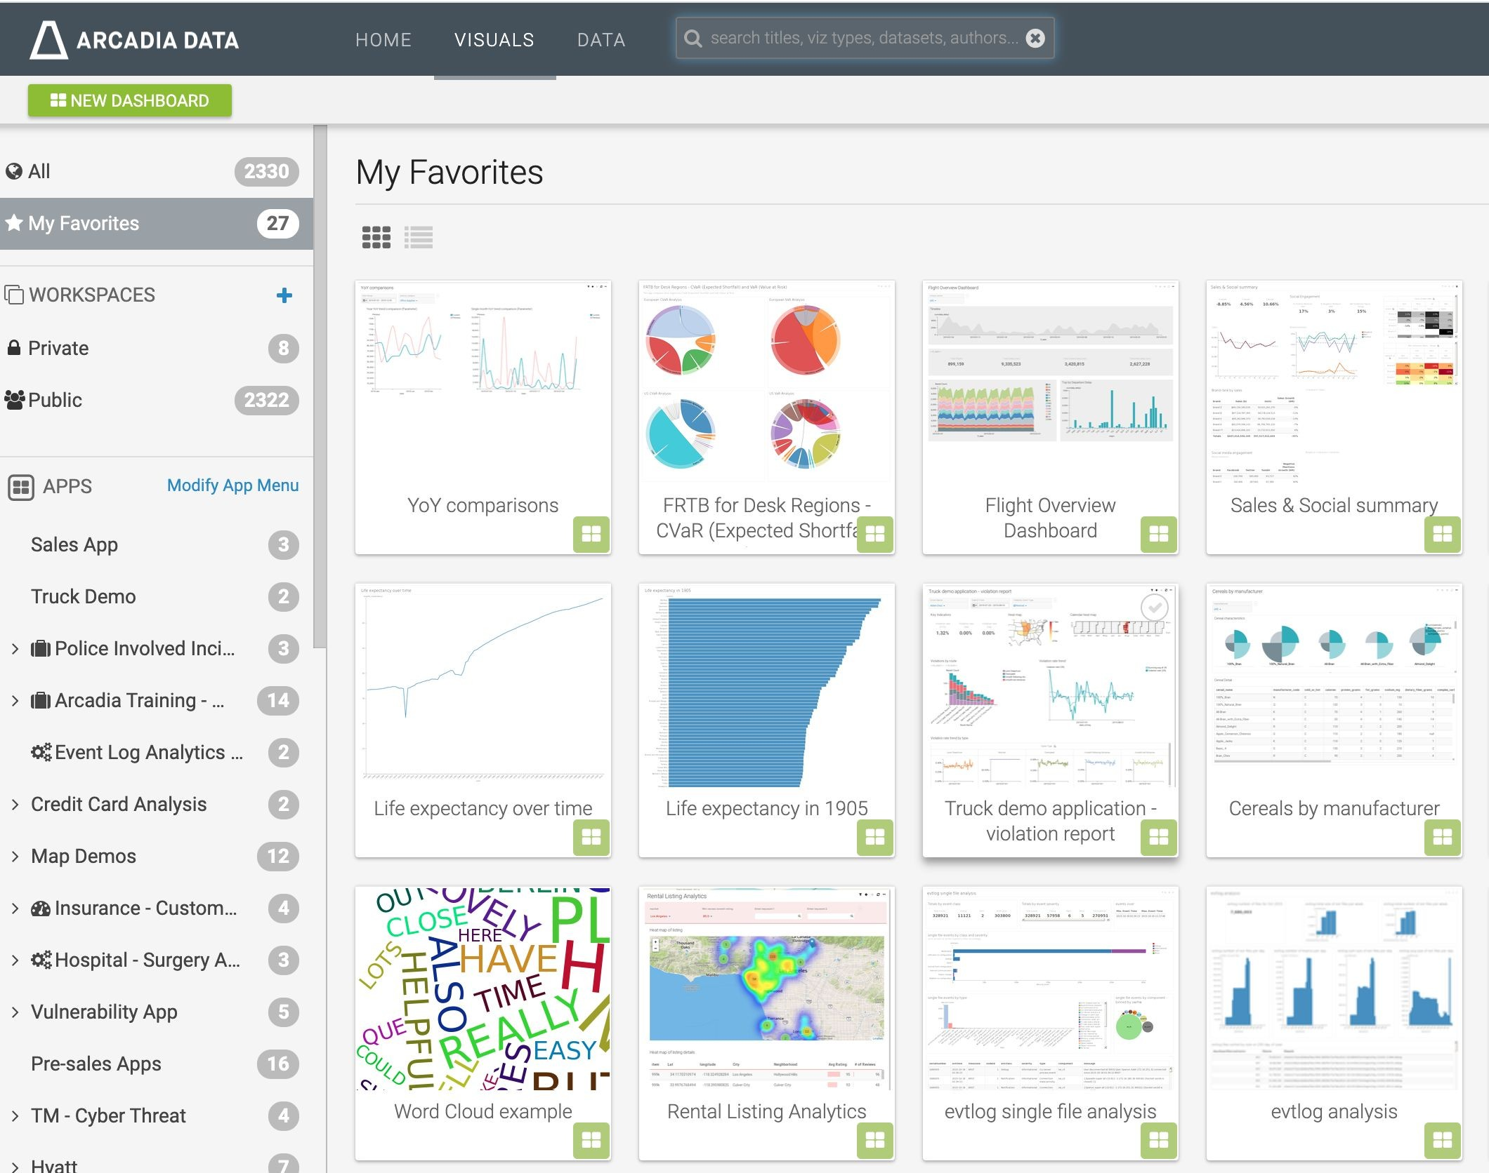
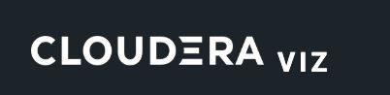
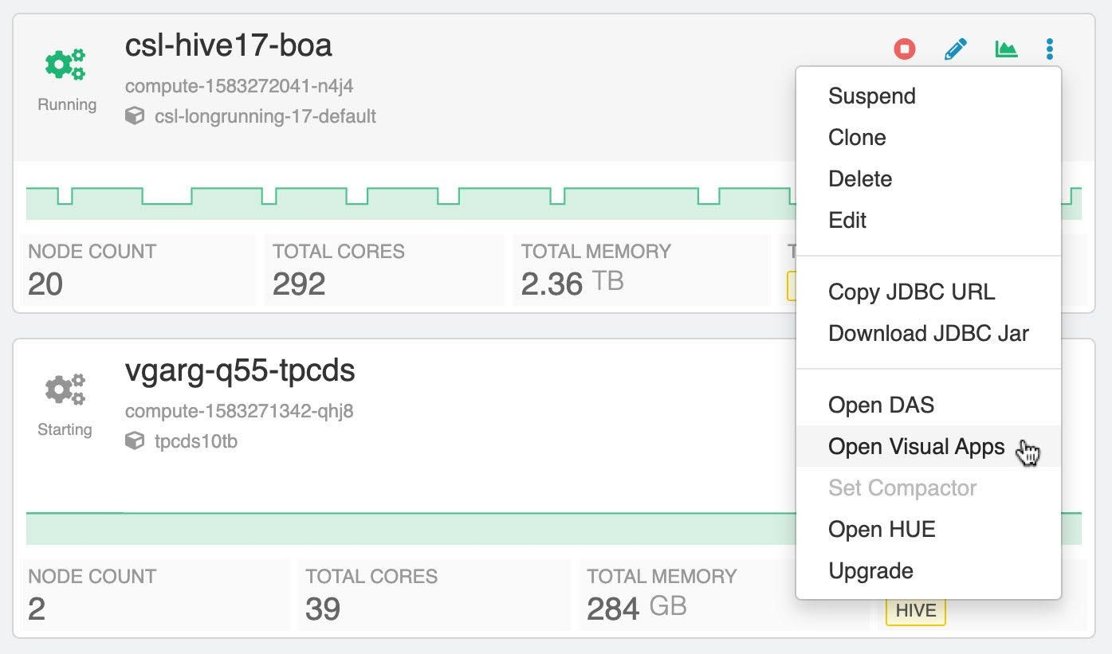
DW Viz in CDW

Slide 34
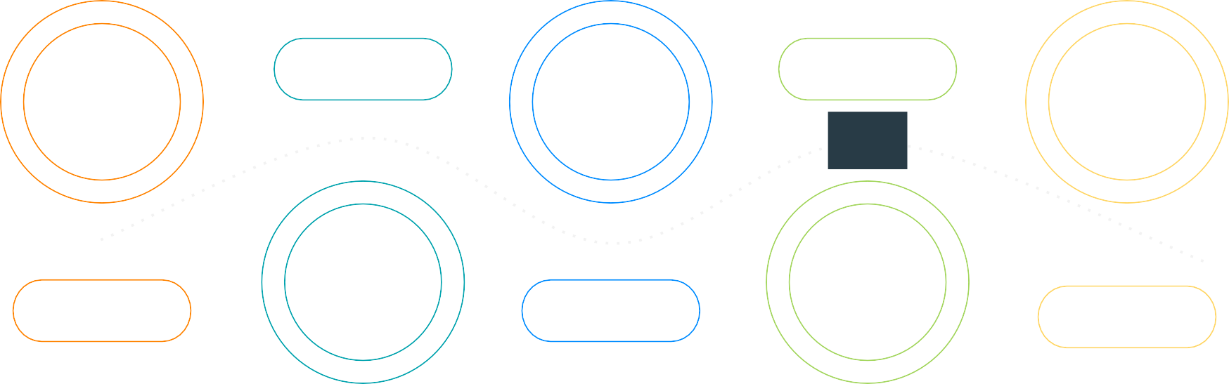
CONNECTING THE DATA LIFECYCLE
Completing the data lifecycle journey - solving the “last mile” problem
CML
ML Ops
05
MACHINE LEARNING & AI
DATA ENGINEERING
OPERATIONAL DATABASE
Collect
Report
02
04
01
STREAMING & DATA FLOW
03
DATA WAREHOUSE
Enrich
Serve
SECURITY | GOVERNANCE | LINEAGE | MANAGEMENT | AUTOMATION

Slide 35




HOW DOES OPDB FIT IN YOUR ENVIRONMENT
In-house apps
DATA FLOW
Streaming sources
ETL
DWH
BI / Analytical reporting
OPERATIONAL DB
Bulk-data sources
Aggregation
DATA WAREHOUSE
DATA ENGINEERING
Mainframe
Operational reporting
Ingest across applications & databases
ML training & serving
MACHINE LEARNING

Slide 36

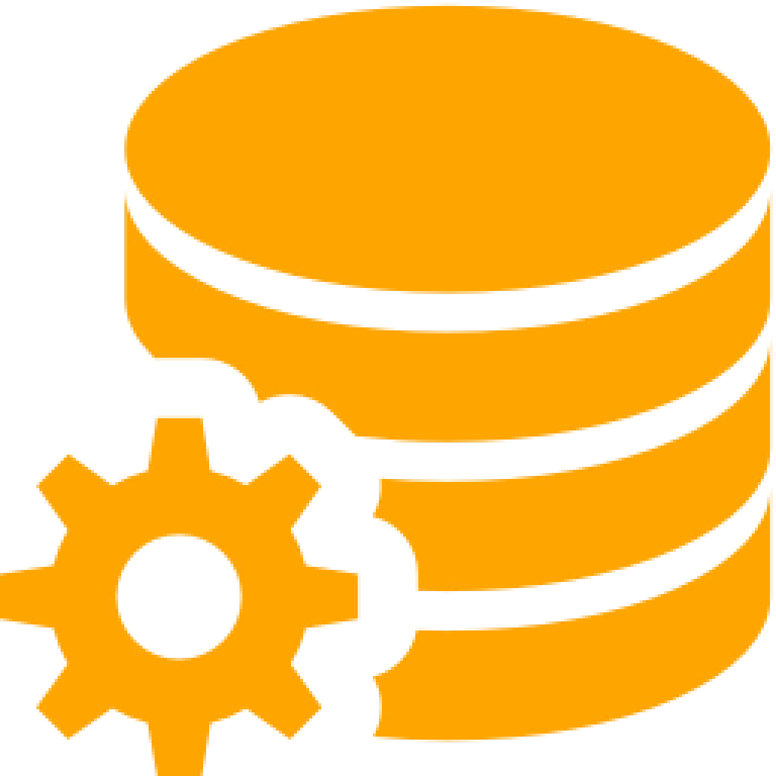
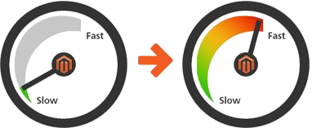


IMPROVES OPERATIONAL AGILITY
Auto-conﬁguration
Auto-scaling
Auto-tuning
Initial conﬁg (e.g., kerberos, cache)
Resiliency (e.g., replication)
Performance optimization for peak needs vs avg needs
Hot spotting
Space management
Eliminate conﬁguration
Auto-setup of kerberos, caching, etc
HA (3 AZs, instance placement groups)
Replication manager enables replication across regions, clouds
Eliminate sizing
Automatically scales up based on application needs
Automatically scales down during periods of low workloads
Eliminate tuning
Detects hotspotting and alleviates it
Eliminates need for region management and rebalancing as data grows

Slide 37


WHAT TO EXPECT IN CDP PUBLIC CLOUD
Allow developers to spend time where it matters
Easy and quick deployment for developers
Autonomous management for admins
3 Clicks
20 Minutes
Auto Scale
Optimizes cloud utilization
Auto Tune
Improves performance
Auto Heal
Resolves operational failures
Reduces deployment time to minutes from weeks/months on legacy databases
Eliminates operational management

Slide 38
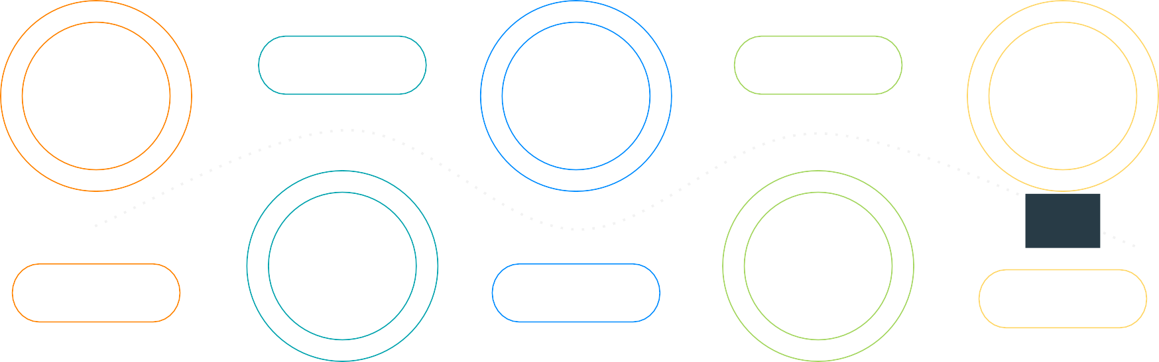
CONNECTING THE DATA LIFECYCLE
Completing the data lifecycle journey - solving the “last mile” problem
DATA ENGINEERING
OPERATIONAL DATABASE
CML
ML Ops
Collect
Report
02 04
01
STREAMING & DATA FLOW
03
DATA WAREHOUSE
05
MACHINE LEARNING & AI
Enrich
Serve
SECURITY | GOVERNANCE | LINEAGE | MANAGEMENT | AUTOMATION

Slide 39
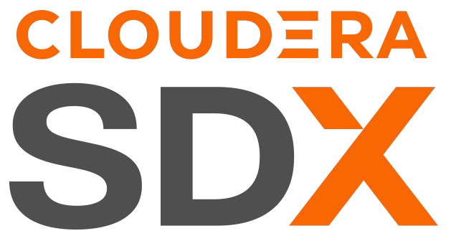
MACHINE LEARNING IN PRODUCTION
Machine Learning Operations
Business Inputs
Data Science
Model Training
Packaging
Deployment & Serving
Monitoring
Data Engineering
Closed Loop ML
Model Security
Model Governance
Model Catalog
Feature Store
Data Catalog

Slide 40
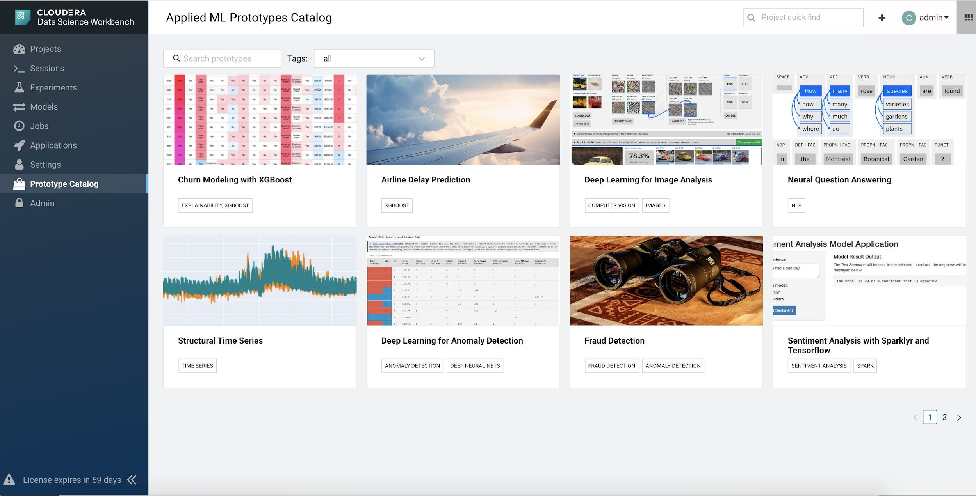
ENABLE LOCAL FEATURE FLAGS
/local-feature-ﬂags

Slide 41
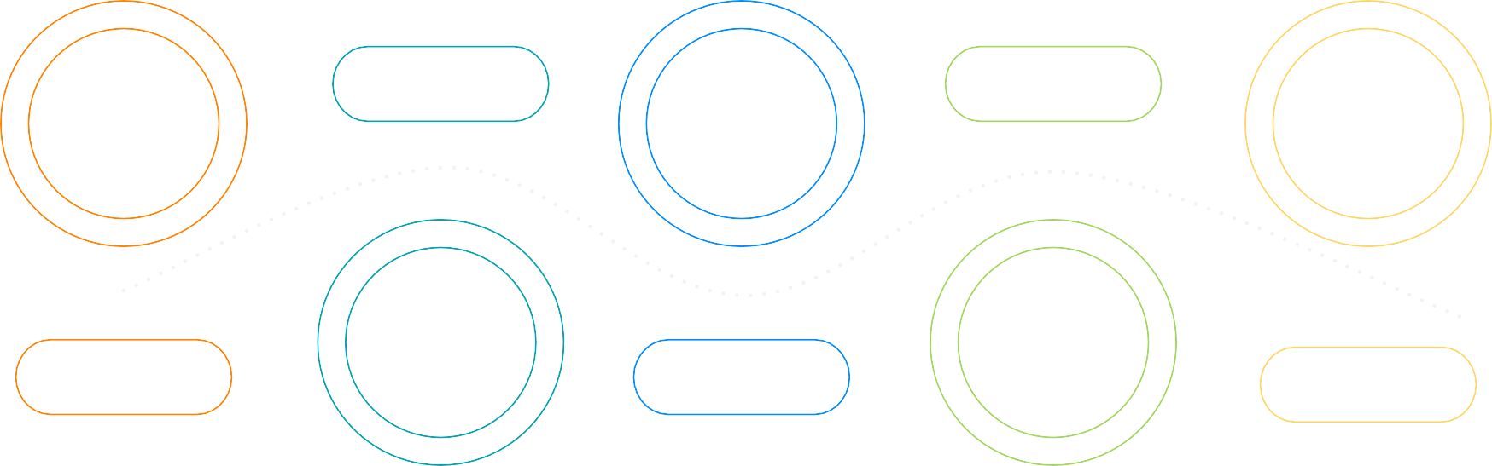
CONNECTING THE DATA LIFECYCLE
Completing the data lifecycle journey - solving the “last mile” problem
DATA ENGINEERING
OPERATIONAL DATABASE
CML
ML Ops
Collect
Report
02
04
01
STREAMING & DATA FLOW
03
DATA WAREHOUSE
05
MACHINE LEARNING & AI
Enrich
Serve
SECURITY | GOVERNANCE | LINEAGE | MANAGEMENT | AUTOMATION

Slide 42
SECURITY

Slide 43

CHALLENGES:
Security & Governance
Sharing data across workloads
Requires multiple copies of data need to be created
Each with its own set of data context
Burdensome admin effort
One missing permission in one copy of the data can lead to signiﬁcant ﬁnancial and reputation risk
Diﬃcult to share data safely for new analyses
Heavy new regulation such as GDPR makes the challenges even greater
- Multiple clusters = multiple places to administer

Slide 44



UNIFIED MANAGEABILITY, SECURITY AND DATA GOVERNANCE
Identity & Perimeter
Validate users in enterprise directory
Access
Deﬁning what users and applications can do with data
Technical Concepts: Permissions Authorization
Visibility
Reporting on where data came from and how it’s being used
Technical Concepts:
Auditing Lineage
Data Protection
Shielding data in the cluster from unauthorized visibility
Technical Concepts: Authentication User/group mapping
Technical Concepts:
Encryption, Key Management
Kerberos, Apache Knox
SSL/TLS, HDFS TDE,
Ranger
(KMS, Masking, Filtering)
Apache Ranger
Apache Atlas

Slide 45

PERIMETER CONTROL : KNOX
Provide a consistent user experience, on all infrastructures and leverage existing directory structure and protocols
Minimize host and port exposure
Strong authentication between users and services automated with Kerberos
Centralized single sign on across all interfaces, which connects to your Active Directory on prem or in the cloud.
Complement Kerberos - hides away complexities of Kerberos from end user applications
Identity & Perimeter
Validate users in enterprise directory
Technical Concepts: Authentication User/group mapping
Kerberos, Apache Knox

Slide 46


ACCESS CONTROL : RANGER & ATLAS
Maintain one set of data, control access centrally with ﬁne grained policies down to the column and the row level.
Anonymize PII with Dynamic column masking
Customize views for users with Dynamic row ﬁltering
Manage user access with Role-based Access Control
Unify policies across many data sets with Attribute-based Access Control
Access
Defining what users and applications can do with data
Technical Concepts: Permissions Authorization
Apache Ranger, Apache Atlas

Slide 47
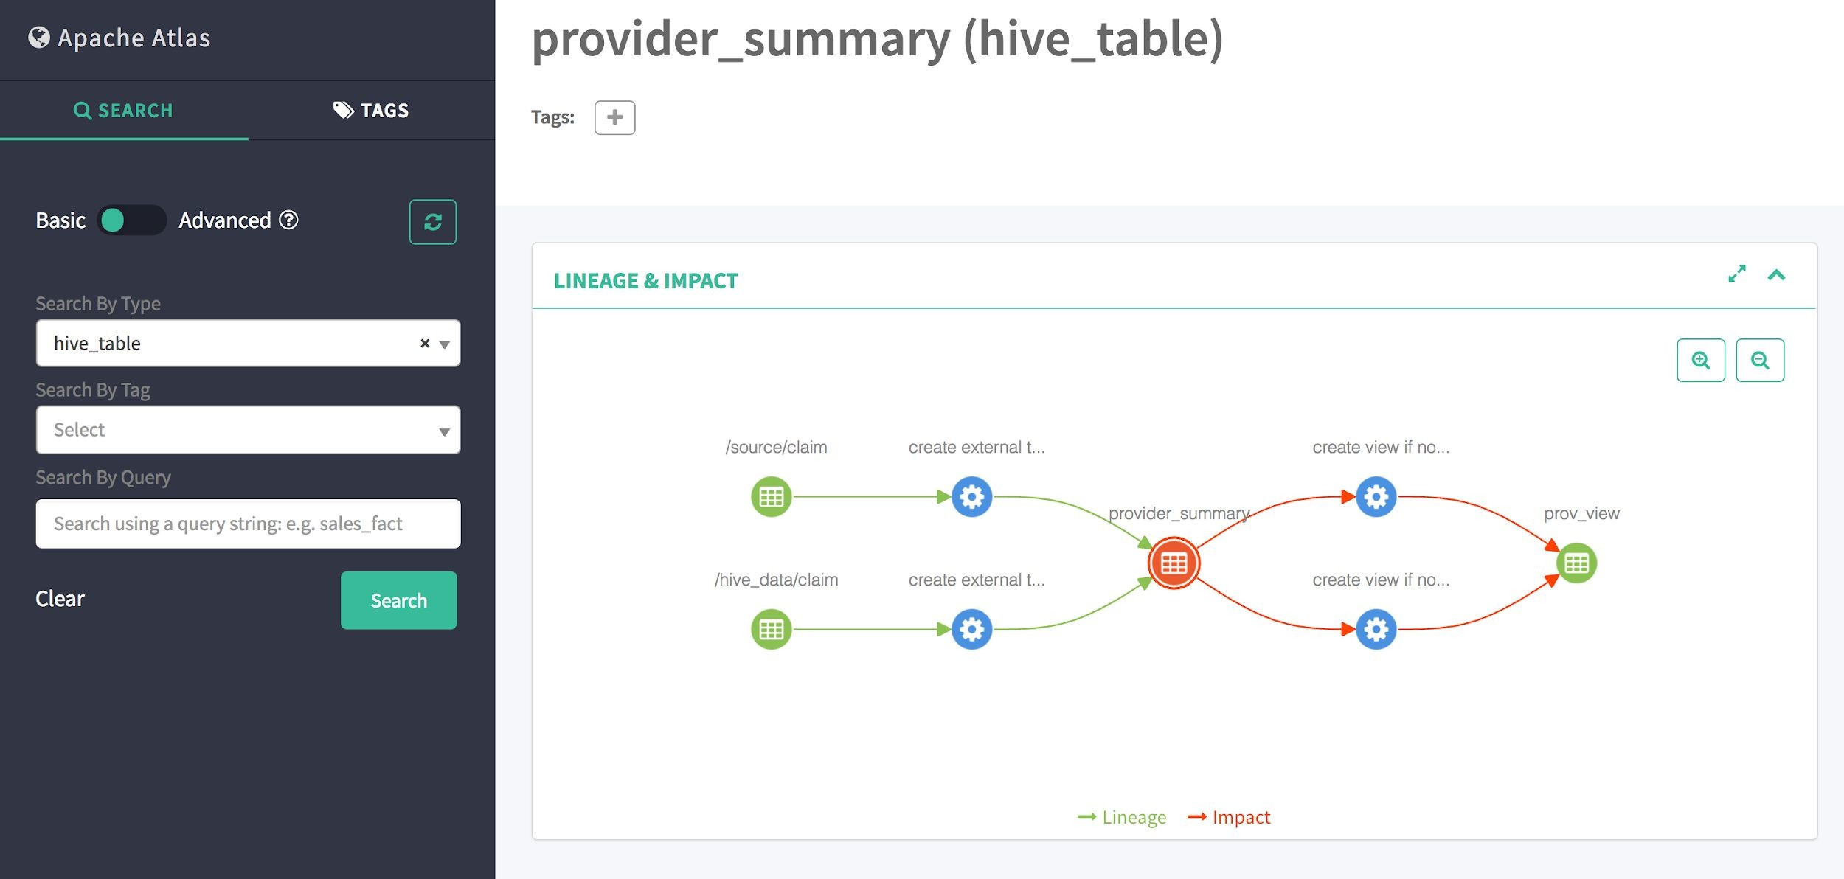
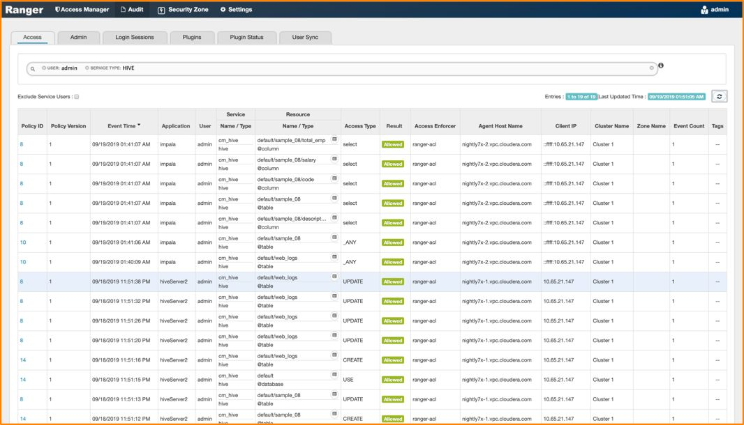
VISIBILITY CONTROL: ATLAS & RANGER
Visibility
Reporting on where data came from and how it’s being used
Technical Concepts:
Auditing Lineage
Lineage
What data do I consume?
What consumes my Data?
Who uses my data?
What data was used to train my model that resulted in X prediction?
•
Audit who accessed what
Track access events from Apache Ranger
Metadata audit and versioning from Apache Atlas
Apache Atlas, Apache Ranger

Slide 48
DATA PROTECTION: ENCRYPTION
Encryption of Data at Rest: Transparent Data Encryption (TDE)
Selective encryption of relevant ﬁles/folders
Prevent rogue admin access to sensitive data
Fine grained access controls
Transparent to client applications. (no changes required)
Enterprise-grade keystore with KTS
Easy key-management with Ranger
Support HSM integration
Data Protection
Shielding data in the cluster from unauthorized visibility
Technical Concepts:
Encryption
Key Management
•
SSL/TLS HDFS TDE
Encryption of Data in Motion: SSL/TLS
Easily enable and manage encryption over-the-wire with AutoTLS

Slide 49
GOVERNANCE

Slide 50





Governance Can Be Complex
It’s an operational tax that adds complexity and slows everything down

Slide 51
Governance Can Be Complex
It’s an operational tax that adds complexity and slows everything down
Sensitive data can propagate!

Slide 52


Governance Can Be Complex
It’s an operational tax that adds complexity and slows everything down
Sensitive data can propagate!
Admins need to set policies on every newly created table or view

Slide 53
Governance Can Be Complex
It’s an operational tax that adds complexity and slows everything down
Sensitive data can propagate!
Admins need to set policies on every newly created table or view
This can be managed with views

Slide 54
Governance Can Be Complex
It’s an operational tax that adds complexity and slows everything down
Sensitive data can propagate!
Admins need to set policies on every newly created table or view
This can be managed with views

Slide 55




Governance Can Be Complex
It’s an operational tax that adds complexity and slows everything down
Sensitive data can propagate!
Admins need to set policies on every newly created table or view
This can be managed with views
Admins need to set perms on every new ﬂavor of table or view created

Slide 56
Governance Can Be Complex
It’s an operational tax that adds complexity and slows everything down
Sensitive data can propagate!
Admins need to set policies on every newly created table or view
This can be managed with views
Admins need to set perms on every new ﬂavor of table or view created
Each interaction takes time and the number of policies can scale exponentially!

Slide 57
Governance in Cloudera SDX is Simpliﬁed
Elegant Auto-propagating Attribute-Based Access Controls and Masking Policies
Sensitive data can propagate!

Slide 58



Governance in Cloudera SDX is Simpliﬁed
Elegant Auto-propagating Attribute-Based Access Controls and Masking Policies
Sensitive data can propagate!
Admins apply Tags to columns and that propagate through lineage.

Slide 59
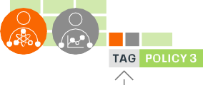

Governance in Cloudera SDX is Simpliﬁed
Elegant Auto-propagating Attribute-Based Access Controls and Masking Policies
Sensitive data can propagate!
Admins apply Tags to columns and that propagate through lineage.
Admins apply Policies to tags that propagate their effects through lineage.

Slide 60
Governance in Cloudera SDX is Simpliﬁed
Elegant Auto-propagating Attribute-Based Access Controls and Masking Policies
Sensitive data can propagate!
Admins apply Tags to columns and that propagate through lineage.
Admins apply Policies to tags that propagate their effects through lineage.
Just deﬁne one tag and one policy and it gets automatically applied to all derived tables!

Slide 61
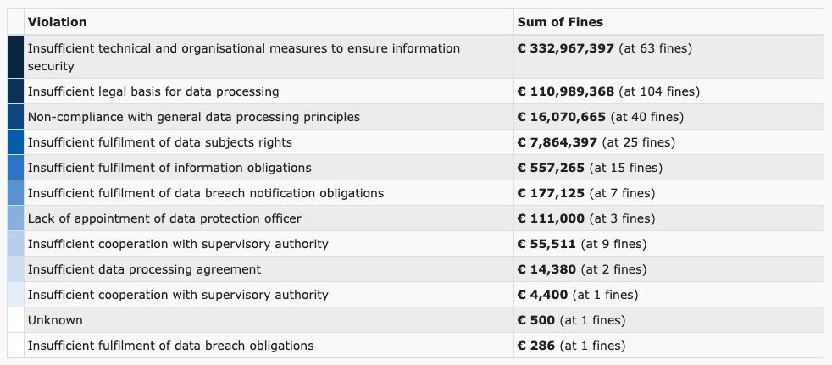

Data Governance is mandatory
Source : GDPR Enforcement Tracker 2018 -2020
Source :HIPAA Fines Listed by Year

Slide 62
UNDERSTAND YOUR DATA
Search
User-driven Text based search
Navigate
Browse to ﬁnd related data sets.
Discover
Automated insights about your data
Crowdsource
Use wisdom of the crowds to better understand data
Technical Concepts: Faceted search Business Glossary
Technical Concepts: Navigation links Breadcrumbs
Technical Concepts:
Proﬁlers
Technical Concepts:
Curation Collections User ratings
Cloudera Data Catalog
Apache Atlas
Cloudera Data Catalog
Apache Atlas
Cloudera Data Catalog
Cloudera Data Catalog
Focus on your data and your people

Slide 63

UNDERSTAND YOUR DATA : SEARCH
via Cloudera Data Catalog and Apache Atlas
Search
User-driven Text based search
Technical Concepts: Faceted search Business Glossary
Cloudera Data Catalog Apache Atlas

Slide 64

UNDERSTAND YOUR DATA : NAVIGATE
Navigate
Browse to ﬁnd related data sets.
Technical Concepts: Navigation links Breadcrumbs
Cloudera Data Catalog Apache Atlas

Slide 65

UNDERSTAND YOUR DATA : NAVIGATE
Navigate
Browse to ﬁnd related data sets.
Technical Concepts: Navigation links Breadcrumbs
Cloudera Data Catalog Apache Atlas

Slide 66

UNDERSTAND YOUR DATA : DISCOVERY
via Cloudera Data Catalog’s Proﬁlers
Discover
Automated insights about your data
Technical Concepts:
Profilers
Cloudera Data Catalog

Slide 67

UNDERSTAND YOUR DATA : CROWDSOURCE
via Data Catalog Asset Collections
Crowdsource
Use wisdom of the crowds to better understand data
Technical Concepts:
Curation Collections User ratings
Cloudera Data Catalog

Slide 68
WHAT DOES ATLAS DO?
METADATA
LINEAGE
CLASSIFICATION
A catalog for metadata of assets in an enterprise
Answers questions of
Classiﬁcations (Tags) with custom attributes
Where did data come from?
Where has it been used?
Hive (HiveServer2 and HMS) , Impala, Spark, HBase, Sqoop, NiFi
Automatic propagation through lineage graph
Use with Classiﬁcation-based
access control (ABAC)
Is automatically maintained for most asset types
Dynamically create asset types with complex attributes and relationships
Extensible type system with
Describe assets with Business
Glossary Terms
Lineage graphs are basis for Classiﬁcation propagation
With relationships between business terms
And associated classiﬁcations
Custom Business Metadata
Labels, properties, etc

Slide 69


CDP DATA CATALOG TARGET PERSONAS
Data Architects
Data Architects
Compliance Managers
Data Users
Data Analysts
Data Engineers
Data Scientists
App Developers Concerns: Understand
Domain Expertise
Insight about Data
Data Quality
Concerns: Control
Compliance / Governance
Data Lifecycle / Curation
Multi-team integration
_{Confiden}© 2_{t}0_{i}2_{a}0 C_{l}lo–uder_{R}a, In_{e}c. A_{s}ll _{t}ri_{r}gh_{i}t_{c}s r_{t}e_{e}ser_{d}ved. 69

Slide 70



CDP — GOVERNANCE & SECURITY
Attribute-Based Access Controls and more with Atlas & Ranger
Policies
Classiﬁcation Based Access & Masking
Prohibition
Time Based, Schedulable Policies
Location
© 2020 Cloudera, Inc. All rights reserved. 70

Slide 71
Cloudera Data Platform Demo

Slide 72

KEY CONCEPTS & COMPONENTS
ENVIRONMENTS
1 Template
1 Region
1 VPC
Multiple Roles/Buckets
Environment
SDX: Security, Governance, & Lineage
Associated with groups/users
1:1
Data Lake
DH templates
ML Env
DW Database Catalogs/Virtual Compute
Data Hub Clusters / Experiences
1:N

Slide 73

ENVIRONMENT
What is an environment?
Deﬁnition of where CDP creates resources in a customer environment.
A long running permanent cluster called a Data Lake gets
created here.

Slide 74

DATA LAKE
What is a Data Lake?
A common set of Services (SDX) within an Environment that are shared across multiple Clusters/Experiences.
These include Services for:
Security
Auditing
Governance
Data Discovery

Slide 75

CONTROL PLANE
What is the Control Plane?
The Control Plane is the common set of tools for management, workload analysis, data movement and
data discovery across multiple environments

Slide 76
More on CDP Technicals

Slide 77

3 FORM FACTORS
CONTROL PLANE
On-Prem Metal Environments
Private Cloud Environments
Public Cloud Environments
DW
clusters
ML
clusters
DH
clusters
DW
clusters
ML
clusters
Cloudera Manager
DE
clusters
ODB*
clusters
CDF*
clusters
DE
clusters
ODB
clusters
CDF
clusters
Runtime 7 (CDP Base 7.x)
Runtime 7 (CDP Base 7.x)
Runtime 7 (CDP Base 7.x)
Co-located Compute and Storage
running on classic bare metal servers
Compute, HDFS/Ozone Storage
backed by K8s and CDP-DC
Compute and Storage
AWS, Azure, GCP

Slide 78
CDP-PVC BASE CLUSTER
(Cloudera Runtime 7.1.6)
CDP RUNTIME 7.1
MANAGEMENT
Cloudera Manager 7.3.1
Workload Manager 2.1.0
Streams Message Mgr. 2.1.0
Replication Manager 1.5.0
Spark 3.1 separate parcel
COMPUTE ENGINES
Spark 2.4.5 Hive 3.1.3
HBase 2.2.3
Leverages Hive on Tez, not MR
A CDP Private Cloud Base cluster (powered by Cloudera Runtime), can serve as a traditional “data lake” (storage & compute) cluster, or as a “base storage cluster” (storage only) serving compute workloads running on Kubernetes.
Kafka 2.4.0
Impala 3.4.0
Phoenix 5.0.0
FRAMEWORKS
Capacity
Scheduler 3.1.1
Parquet 1.10.99
Livy 0.6.0
FS -> CS
Migration
ZK 3.5.5
ORC 1.5.1
Oozie 5.1.0
SECURITY & GOVERNANCE
This image shows the component versions in Cloudera Runtime 7.1.6.
HMS 2.0.0
Ranger
2.0.0
Atlas 2.0.0
Knox 1.3.0
Many teams running HDFS 2.6.0
STORAGE
Kudu 1.12.0
This is the
G.A. release
Click HERE for the complete list of supported components.
HDFS 3.1.1
Ozone 1.0

Slide 79



































CDP - AWS HIGH LEVEL ARCHITECTURE
Customer AWS Account
Cloudera Cloud
FreeIPA Services
SDX Data Lake
Data Hub
K N O X
Cloudera Runtime (all services)
Features:
PaaS
Manual Scaling Custom Templates
User
KDC
Ranger
Data Catalog
LDAP
Atlas
EC2
S3
In-built deﬁnitions
CLI
DLM
DNS
IDBroker
Replication Manager
Data Warehouse Experience
BDR
CA
Hive Metastore
Web UI
Workload Analytics
Hive (w LLAP)
Features:
PaaS
Fast Auto Scaling JDBC connectivity
SAML
Federation
Cloudera Manager
Impala
SDK
Identity Management
EKS
S3
DAS & Hue
ID Broker Mapping
Amazon EC2
Mgmt, Orchestration, & Monitoring Services
Machine Learning Experience
Amazon EC2
ML Workbench
Features:
PaaS
Fast Auto Scaling GPU support
Spark
Control Plane APIs
S3 Storage
EKS
S3
Python/R
Amazon RDS
Data Engineering Experience
Cross Account
Access IAM Role
Spark
Features:
PaaS
Fast Auto Scaling Job Management
S3 Storage
Airﬂow
Amazon IAM
EKS
S3
Safari (perf-mon)
KNOX

Slide 80










CDP - AZURE HIGH LEVEL ARCHITECTURE
Customer Azure Resource Group
Cloudera Cloud
FreeIPA Services
SDX Data Lake
Data Hub
K N O X
Cloudera Runtime (all services)
Features:
PaaS
Manual Scaling Custom Templates
User
KDC
Ranger
Data Catalog
LDAP
Atlas
VMs ADLS Gen2
In-built deﬁnitions
CLI
DLM
DNS
IDBroker
Replication Manager
Data Warehouse Experience
BDR
CA
Hive Metastore
Web UI
Workload Analytics
Hive (w LLAP)
Features:
PaaS
Fast Auto Scaling JDBC connectivity
SAML
Federation
Cloudera Manager
Impala
SDK
Identity Management
AKS ADLS Gen2
DAS & Hue
ID Broker Mapping
VMs
Mgmt, Orchestration, & Monitoring Services
Machine Learning Experience
VMs
ML Workbench
Features:
PaaS
Fast Auto Scaling GPU support
Spark
Control Plane APIs
ADLS Gen2
AKS ADLS Gen2
Python/R
PostgreSQL
Data Engineering Experience
AAD App/w
Contributor Role
Spark
Features:
PaaS
Fast Auto Scaling Job Management
ADLS Gen2
Airﬂow
Access Control
AKS ADLS Gen2
Safari (perf-mon)
KNOX

Slide 81









CDP - GCP HIGH LEVEL ARCHITECTURE
Customer GCP Project
Cloudera Cloud
FreeIPA Services
SDX Data Lake
Data Hub
User
Ranger
Features:
PaaS
Manual Scaling Custom Templates
Data Catalog
KDC
Atlas
CLI
GCP GKE
LDAP
IDBroker
DNS
Cloudera Runtime (all services)
Web UI
Hive Metastore
Workload Analytics
CA
SAML
Federation
Cloudera Manager
In-built deﬁnitions
SDK
Identity Management
ID Broker Mapping
Mgmt, Orchestration, & Monitoring Services
Compute
Compute
Compute
Control Plane APIs
Storage
Cloud SQL
Cloud SQL
Provisioning Service Account
Storage
Storage
Cloud IAM
KNOX
KNOX

Slide 82


CDP Private Cloud – Dedicated Kubernetes
1. Install Mgmt Console
Management Console
CML CDW
3. Deploy
Workspaces
CML Wor
kspace
Virtu Wareh
al ous
e
Virtu Wareh
al ouse
CM
CDP PVC BASE 7.x
Network
HDFS /
Ozone
Spark-on- K8s
Python, R
Autoscale
HMS Ranger
Atlas
Environment
2. Create Environment
Compute Capacity
Bare metal or VMs
Openshift Kubernetes Cluster
Conﬁdential — Restricted

Slide 83

CDP Private Cloud – Embedded Version
CDP 7.x
CDP PLUS EXPERIENCES
Management Console
CML CDW
CM
Workspaces
DEPLOY AND MANAGE
CML Workspace
Virtu Wareh
al ous
e
Virtu Wareh
al ouse
DEPLOY AND MANAGE
Spark-on- K8s
Python, R
Autoscale
Environment
CDP BASE CLUSTER
HDFS / Ozone | HMS | Ranger | Atlas
EMBEDDED K8S CLUSTER
Embedded PV Storage | NFS | Container Reg | postgresql | vault
Network
Bare metal or VMs
Conﬁdential — Restricted

Slide 84





THREE PATHS TO CDP
Migrate to Public Cloud
Migrate to CDP PVC-Base
Upgrade to CDP PVC-Base
CDP
CDP
CDP
Copy data and metadata to a public cloud; implement new, or migrate existing workloads on CDP Public Cloud.
Build a new CDP PVC-Base cluster on-premises; copy data and metadata from existing classic cluster; and migrate existing workloads.
Upgrade from classic cluster to CDP PVC-Base in-place on the same hardware infrastructure.
Small initial investment
Higher initial investment
Single cutover, lower capital investment

Slide 85



CDP Private Cloud
MIGRATING TO A NEW INSTALL
Management Console
Cloudera
Manager
Data Catalog
Replication Manager
Workload Manager
Container Cloud
ML DW
Data Hub
...
Intelligent Replication (workloads)
CDH / HDP
CDP PVC Base
Intelligent Replication (data, metadata, policies)
Storage

Slide 86


MIGRATE TO PUBLIC CLOUD
Process
Set up public cloud environments
Register classic cluster(s)
Identify candidate workloads
Migrate workload data and metadata using Replication Manager (“Burst to Cloud”)
Test and promote to production

Slide 87
BURST TO CLOUD
Management Console
Workload Manager
Data Catalog
Replication Manager
Workload Manager identiﬁes burstable workloads
Replication Manager replicates targeted datasets to cloud (data, schema, policies, & lineage)
CDP Cloud Environment
DataHub Clusters
CD^{D}W^{W}
_{C}C_{lu}lu_{s}s_{te}t_{r}e_{s}rs
CM^{M}L^{L}
_{C}C_{lu}lu_{s}s_{te}t_{r}e_{s}rs
CDH / HDP / CDP
Existing Apps
AWS
Azure
GCP
Existing Data
Existing Hardware

Slide 88
Packaging, Pricing & Value Proposition

Slide 89




CDP CUSTOMER ADOPTION
Early customer feedback is positive on 3 dimensions...Security | Cost Savings | Performance
CDP eliminates the need to compromise. Its workload management enables an optimal customer experience without overprovisioning. And with SDX, we don’t have to sacriﬁce governance to deliver a great customer experience. With CDP, we get security, customer experience and lower costs.
CDP became a clear choice for two reasons. First, enterprise security and governance, at which Cloudera has always excelled. But also lower costs. CDP’s Data Warehousing auto-scales up and down. This means we only use and pay for what we need -- Cloudera’s service and cloud infrastructure.
CDP’s cloud-native Machine Learning is a great example of an innovative analytics service. It helps our data scientists experiment faster and collaborate better. Our IT organization likes it because it keeps them in control and embraces shadow IT. This is crucial to delivering innovation while ensuring security and governance.
© 2020 Cloudera, Inc. All rights reserved. 100

Slide 90
CDP Core Products — Today’s products
CDP PVC Base — Upgraded data and analytics platform
PRODUCTS
SDX — End-to-end security and governance
CFM — Flow Management
CSA — Streaming Analytics
CDSW — Machine Learning
CDP Data Hub — Cloudera’s cluster-as-a-service for AWS, Azure, GCP
10 Templates - Optimized for migrating apps to cloud without rewrite
CDP Data Services (Improved) — Cloudera’s next generation cloud-native data services optimized for practitioner experience
DF (New), DE, DW, OD, ML — Ease of use & management
CDP PaaS — Customer choice and control
CDP SaaS (Coming Soon) — Customer self-service & simplicity
CDP PVC Data Services (New) — Optimized for modernizing apps on prem to accelerate time to value and improving practitioner experience
© 2020 Cloudera, Inc. All rights reserved. 100

Slide 91
CDP DATA SERVICES
Practitioner-grade experience, for building and operating multi-function applications
PVC BASE & DATA HUB |  | CDP DATA SERVICES
Servers | → | Services
Monolithic | → | Modular
Co-Located Storage & Compute | → | Separated Storage & Compute
HW Dependent | → | SW Defined
Operator Focused | → | Practitioner Focused
Optimized for Existing Applications | → | Optimized for New Applications
Static Workloads | → | Portable Workloads
© 2020 Cloudera, Inc. All rights reserved. 100

Slide 92







CDP Public Cloud Services
Initially AWS; Azure and GCP
© 2020 Cloudera, Inc. All rights reserved. 100

Slide 93
Data Warehouse Data Service on AWS - Minimum Hardware Requirement
Data Warehouse Data Service (Hosted on EKS)
Resource Type | Minimum Count | Scaling | Persistent | Purpose
m5.2xlarge | 3+ | Auto | Yes | Database Catalog - Shared Services Nodes (Max = 20 Nodes)
r5d.4xlarge | 2 | Auto | No | Reserved Capacity - Compute Nodes (Default = 2, see notes below)
r5d.4xlarge | user defined | Auto | No | Virtual Warehouse Compute Nodes (T Shirt sizing)
db.r4.large | 1 | N/A | Yes | RDS DB Instance (PostgreSQL)
© 2020 Cloudera, Inc. All rights reserved. 100

Slide 94
CDP PRIVATE CLOUD PACKAGING
MAX edition (roadmap)
PLUS +
All Experiences
Additional features (TBD)
PLUS edition
BASE +
Control Plane (DC, WM, RM)
Any two (2) Experiences
Analytic compute multiplexing
Management Console
Data Catalog
Workload Manager
Machine Learning
Data Warehouse
Data Engineering
Data Flow
OpDB
Replication Manager
Experiences
Burst to Public Cloud experiences
Kubernetes (Bring Your Own Kubernetes = OpenShift)
BASE edition (aka DC)
Data Hub clusters
Storage management
SDX
Data Hub Clusters
Bare metal workloads
SDX
Security, Governance, Lineage & Metadata
HDFS + Ozone
Bare Metal
© 2020 Cloudera, Inc. All rights reserved. 100

Slide 95
CDP PRIVATE CLOUD – HARDWARE REQUIREMENTS
Bare metal or VMs
OpenShift/ECS Cluster
Component | Minimum | Recommended | Minimum | Recommended
Number of servers | 6 | 8 | 14 | 20
CPU (cores) | 16 cores | 24 cores | 16 cores | 32 cores
RAM (GB) | 32GB | 128GB | 128GB | 384GB
Storage HDD (Num x Capacity ) | 12 x 2TB | 12 x 4TB | 2TB (SATA) | 4TB (SSD/NVMe)
Network | Minimum: 1Gbps guaranteed bandwidth between any 2 nodes in the cluster (this is worst case bandwidth, under full load). Recommended: 10Gbps guaranteed bandwidth. Topology Recommendation: 25+GbE Spine/Leaf, max 4:1 oversubscription between the spine and leaf switches.
© 2020 Cloudera, Inc. All rights reserved. 100

Slide 96

CDP PRIVATE CLOUD: WHAT IS PRICED & LICENSED?
Data Services | Data Engineering | $650/CCU
 | Data Warehouse
 | Machine Learning
 | Ozone Object Store with SDX | $10,000/Node
 | Select 3rd Party Storage with SDX
Base |  | + Variable Compute
 | HDFS with SDX
 |  | & Storage
 | Traditional Data Clusters
Data Services
MANAGEMENT DATA REPLICATION WORKLOAD
CONSOLE
CATALOG MANAGER MANAGER
DF DE DW OD ML
K8S Containers - OCP, OKE, etc.
Base
FILE & OBJECT STORE | HDFS |  | OZONE
DATA HUB
Cloudera Compute Unit (CCU) - 1 Core and 8 GB RAM
Variable compute price: $75 per CCU over 16 Cores / 128GB RAM Node cap;
Bare Metal Servers
Variable storage price: HDFS: $25 per TB over 48TB Node cap or Ozone/Third Party Storage $100 per TB over 48TB Node cap.
© 2020 Cloudera, Inc. All rights reserved. 100

Slide 97


CDP PRIVATE CLOUD INFRASTRUCTURE GUIDE
https://infohub.delltechnologies.com/section-assets/infrastructure-guide-cdp-private-cloud
© 2020 Cloudera, Inc. All rights reserved. 100

Slide 98














ENABLING ANALYTICS & INSIGHTS ANYWHERE
Driving Enterprise Business Value
DATA SCIENCE/ MACHINE LEARNING
ANALYTICS & INSIGHTS
STREAMING DATA SOURCES
Stream Ingest
Deploy Models
[SQL]
REAL-TIME STREAMING ENGINE
Clickstream
Sensors
BI SQL
Solutions
Predictive Real-Time
Analytics
Apps
Actions & Alerts
Model Building
Model Training
Model Scoring
Video
Social
ENTERPRISE DATA SOURCES
CENTRALIZED DATA PLATFORM
STORAGE & PROCESSING
DATA WAREHOUSE
POS
Labor CRM
Ingest – Data at Rest
Price & Promo’s
Omni- Supply Inventory Chain
© 2020 Cloudera, Inc. All rights reserved. 100

Slide 99



CLOUDERA RECOGNIZED IN FORRESTER WAVES
Streaming Analytics Data Warehouse
Machine Learning
The Forrester Wave™ is copyrighted by Forrester Research, Inc. Forrester and Forrester Wave™ are trademarks of Forrester Research, Inc. The Forrester Wave™ is a graphical representation of Forrester’s call on a market and is plotted using a detailed spreadsheet with exposed scores, weightings, and comments. Forrester does not endorse any vendor, product, or service depicted in the Forrester Wave™. Information is based on best available resources. Opinions reflect judgment at the time and are subject to change.
© 2020 Cloudera, Inc. All rights reserved. 100

Slide 100
CLOUDERA - THE ENTERPRISE DATA CLOUD COMPANY
Manage and secure the data lifecycle in any cloud or datacenter
DATA ENGINEERING
OPERATIONAL DATABASE
Collect
Report
Predict
02
04
01
STREAMING & DATA FLOW
03
DATA WAREHOUSE
05
MACHINE LEARNING & AI
Enrich
Serve
SECURITY | GOVERNANCE | LINEAGE | MANAGEMENT | AUTOMATION
© 2020 Cloudera, Inc. All rights reserved. 100

Slide 101





POINT SOLUTIONS HAVE AN INTEGRATION TAX
Security & governance is an afterthought
DATA ENGINEERING
OPERATIONAL DATABASE
02
04
01
03
05
STREAMING & DATA FLOW
DATA WAREHOUSE
MACHINE LEARNING & AI
SECURITY | GOVERNANCE | LINEAGE | MANAGEMENT | AUTOMATION
© 2020 Cloudera, Inc. All rights reserved. 100

Slide 102






POINT SOLUTIONS FROM PUBLIC CLOUD PROVIDERS
Building blocks
DATA ENGINEERING
OPERATIONAL DATABASE
02
04
Kinesis
Redshift
Sagemaker
01
Glue
Glue
03
Glue
Glue
05
Lake Formation
Lake Formation
Lake Formation
Lake Formation
STREAMING & DATA FLOW
DATA WAREHOUSE
MACHINE LEARNING & AI
EMR
DynamoDB
CloudTrail
CloudWatch
CloudTrail
CloudWatch
SECURITY | GOVERNANCE | LINEAGE | MANAGEMENT | AUTOMATION
© 2020 Cloudera, Inc. All rights reserved. 100

Slide 103
Key points to consider – CDP Vs AWS Native Offerings
Hidden Costs - Customers can accrue significant costs associated with EMR especially for long running applications – engineering, compute, storage
AWS offerings are optimized for a small to mid-sized cost-conscience company with no Hadoop expertise in-house.
Security - Ranger, Atlas, Knox and Kerberos are not available in EMR without a lot of manual configuration and using a third party to mask sensitive data or track data lineage. GDPR-like functionality is not possible to address in EMR.
Portability - lift&shift from an on-prem to EMR is very impractical and needs a lot of hacking around
No “STOP” feature - EMR’s biggest pitfall is the inability to shut-down and restart when needed. It needs to be reprovisioned.
Cloudera |  | AWS EMR
Unified Security / Governance | ✔ | Lake Formation*
Data Engineering | ✔ | EMR*
Machine Learning ✔ Sagemaker* Data Warehouse ✔ Redshift*
Ingest / Streaming | ✔ | Kinesis*
Unified Data Platform | ✔
Hybrid Cloud | ✔ | Outpost*
Open Source | ✔
Long Running Cost Optimized | ✔
© 2020 Cloudera, Inc. All rights reserved. 103

Slide 104

© 2020 Cloudera, Inc. All rights reserved. 104

Slide 105

© 2020 Cloudera, Inc. All rights reserved. 104

Slide 106



Cloud Data Warehouse Performance Testing - January 2021
CLOUD DATA WAREHOUSE PERFORMANCE TESTING
Price-Performance Comparison (Lower is Better)
$600
$511.09
$500
Cloudera Delivers Better Price Performance
$400
$300
Industry standard TPC Benchmark 20% lower costs than
Amazon Redshift
40% lower costs than Microsoft Synapse
80% lower costs than “DW1” 550% lower costs than “DW2”
$200
$166.87
$110.73
$133.55
$100
$93.43
$0
Cloudera
Redshift
Synapse
DW1
DW2
More can be learned about the TPC-DS benchmark at http://www.tpc.org/tpcds/.
Prepared by: McKnight Consulting Group, www.mcknightcg.com January 2021
© 2020 Cloudera, Inc. All rights reserved. 104

Slide 107

© 2020 Cloudera, Inc. All rights reserved. 104

Slide 108


What's in it for you?
DATA LIFECYCLE | vs | SINGLE FUNCTION
HYBRID & MULTI | vs | CLOUD ONLY
SECURE & GOVERNED | vs | BASIC SECURITY
OPEN SOURCE | vs | PROPRIETARY LOCK-IN
PLATFORM | vs | POINT SOLUTION
© 2020 Cloudera, Inc. All rights reserved. 104

Slide 109
CDP Upgrade/Migration https://docs.cloudera.com/cdp/latest/upgrade.html
Reference Architectures https://docs.cloudera.com/documentation/other/reference-architecture.h tml
Key Bookmarks
Pricing Related
https://www.cloudera.com/products/pricing.html
Partner Portal https://my.cloudera.com/partner-portal.html
© 2020 Cloudera, Inc. All rights reserved. 104

Slide 110



Register onto Partner Portal 🡪 https://my.cloudera.com/partner-portal.html
CDP On-boarding 🡪 Setup your CDP Demo & working environment
Fill-in form for enabling licenses
Get your AWS/Azure account for infrastructure
Get your pre-requisites ready Use Starter kit to setup CDP
Call to Action
Joint Customer Pursuits & Pro-active engagements on CDP Upgrade
More Enablement & Hands-on Workshops
© 2020 Cloudera, Inc. All rights reserved. 104

Slide 111
Q&A

Slide 112
THANK YOU

